Slide 1
Wright Brothers
1896 - 1914
Notes:
Prior to World War I, aviation consisted of biplanes and experimental aircraft, balloons, dirigibles, and airships. Wilbur and Orville Wright made their historic flight on 17 Dec 1903. Airplane development continued to develop in America and Europe. In 1905, the Wright brothers were in the forefront of airplane design. They retired from flying for three years while they were in litigation with airplane patents. Octave Chanute inspired some of the European efforts for airplane development.

Slide 2
Modern Aviation Influences
Chinese kite
Primitive aeroplane
Supported in the air by the action of wind upon an inclined surface
Windmill
Recognized significance as propeller

Slide 3
Sir George Cayley
Considered first aeronautical engineer
Idea conceived in 1804
Defined problem
Mechanical flight vs chemical flight
Sketched fixed-wing glider
Empennage
Fuselage
Wing
1809 - built model glider and flew

Slide 4
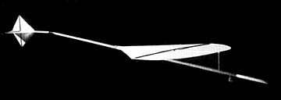
Cayley’s 1804 Glider

Slide 5
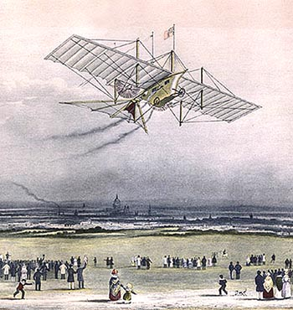
Henson & Stringfellow
Organized Aerial Transit Company
Built 20-foot model of monoplane
Test flight in 1847
Failed to fly
Demonstrated possibility of
heavier-than-air flight
Built 10-foot model
“Launch-by-wire” aircraft

Slide 6
Felix du Temple
Flew steam-powered model in 1857
Built full-size model
Used tractor propeller
1874 – rolled down ramp and hopped into air
Used high-speed circulation steam engine
Notes:
Henri Farman's Aeroplane at Ghent, 1908 Collection of Jean-Pierre Lauwers
Farman Type 40 (Engine Renault 130 hp) of the Aéronautique Militaire seen at Houtem in the Spring 1915.

Slide 7
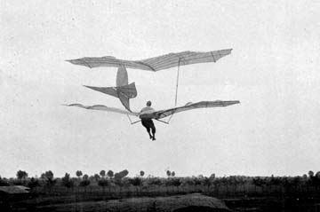
Otto Lilienthal
Constructed/flew gliders
Logged nearly 2,000 glider flights
Constructed
5 types of monoplane gliders
2 bi-plane gliders with bat-wing shape
Notes:
Farman Type 40 (Engine Renault 130 hp) of the Aéronautique Militaire seen at Houtem in the Spring 1915.

Slide 8
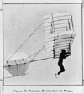
Octave Chanute
Engineer of complex bridges and railroad terminals
Interested shifted to aviation
Compiled “Progress in Flying Machines”
Notes:
The American and European aviation industries began to develop within a few years of each other, but Europe took the first formal steps to establish dedicated aircraft companies in the early decades of the 20th century. During this time, there was a shift from aircraft designers, builders, and pilots all being the same people to having entrepreneurs who ran the business and built the planes and others who flew them.
In England, the Short brothers—Horace, Albert, and Hugh, three experienced balloon-makers, established the first British airplane manufacturing company in 1908. After two unsuccessful planes, Albert obtained a license from Wilbur Wright in February 1909 to manufacture six Wright airplanes in Britain. This order made the Short company the first to produce a series of planes, rather than one of a model.
The brothers went on to design and build their own aircraft. Horace designed their first successful airplane, the Short biplane No. 2. In 1913, they produced a seaplane with folding wings that allowed the plane to be parked on a ship. In 1915, the Seaplane 184 was the first aircraft to sink a ship with a torpedo, when it sank a Turkish merchant ship in the Dardanelles. This bomber saw service until better heavy bombers came along and the Short was reassigned to reconnaissance duties. They also built a small number of land-based bombers and what some claim to be the first twin-engine plane to fly—the Triple-Twin biplane.

Slide 9
Chanute
William Avery - Gliding
St Louis World Fair
Flown more than 40 times at Fair
Became mentor to Wright Brothers
Witnessed early Wright flights

Slide 10
Wright Brothers
Lived in Dayton Ohio
Opened bicycle shop
Aviation interest
Lilienthal’s death
Pilot control was key successful and safe flight
Began glider flights to solve problem
Problems of mechanical flight
Stability
Maneuverability
Design relatively unstable airplane

Slide 11
Wright Gliders
1900 Glider – (bi-plane) only flew a few days
Wilbur flew as a kite (tethered)
Most were unpiloted
By design unstable
Wing warping controlled by wings
Pilot in prone position
1901 Glider (50 – 100 flights in summer)
Larger wing surface
2 disappointments
Only produced 1/3 lift calculated
Wing warping sometimes responded in opposite direction
Known as adverse yaw

Slide 12
Wright Gliders
Determined equations calculating lift were wrong
Built wind tunnel
Conducted systematic tests on miniature wings
Basic test on 200 wings of many shapes
Detailed tests on 38 of them
Longer narrower wings were an important discovery
1902 Glider (1,000 flights in summer)
Made airfoil flatter (reduce camber)
Discarded Lilienthal’s data
Fixed, rear vertical rudder
Eliminate adverse yaw
Hinged rudder and wing warping together

Slide 13
Wright Gliders
1902 Glider (Con’t)
Rudder
Aim or align aircraft correctly during banking turns
Three-axis control evolved
Wing warp – lateral motion
Forward elevator – up and down
Rear rudder – side to side
1902 Glider
Achieved true control on Oct 8, 1902
Now ready to add power
Invention of the airplane

Slide 14
Adding Power
1903 Wright Flyer I
Carved own wooden propellers
Built gasoline engine in bicycle shop
Charles Taylor built engine in 6 weeks
Used aluminum for weight
Weeks of delays
Broken propeller shafts

Slide 15
First Attempt
14 Dec 1903
Rail laid downhill and into the wind
Landing gear was skids
Wilbur Wright won coin toss
Stalled after takeoff, damaging Flyer
Nose up too high – pilot error
Flyer repaired

Slide 16
17 Dec 1903
Orville’s Turn
Rail moved to level ground
5 witnesses and a camera for verification
120’ in 12 seconds
Attributed shortness to lack of experience
Achieved first manned, powered, controlled, and sustained flight in the airplane

Slide 17
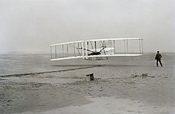
17 Dec 1903
Wilbur
175 feet in 11 seconds
Orville
200 feet in 15 sec
Wilbur
852 feet in 59 seconds
Damaged plane

Slide 18
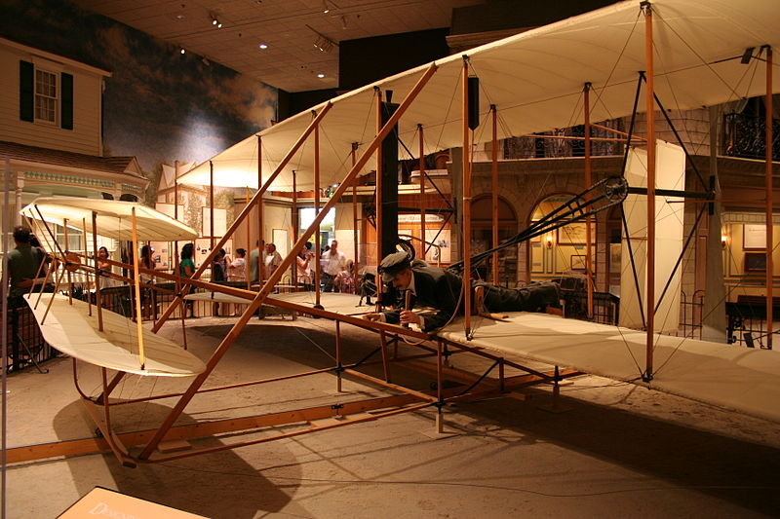

Slide 19
Wright Patent
1903 application
Dismissed
Hired lawyer – Henry Toulmin
Claim of a new/useful method to control flying machine
Wing warping and other methods
Steerable rear vertical rudder and combination with wing warping
Forward elevator
Glenn Curtiss and others devised ailerons

Slide 20
1904
1903 Flyer was not practical aircraft
Set up at Huffman Prairie
Built airport
Removal of bar wire fences
Construction of hanger
Installation of launch rails
Developed Wright Flyer No. 2
Less camber/more horsepower
New propeller gearing

Slide 21
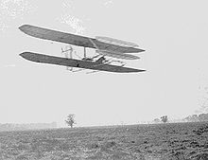
1904
Required longer starting rails
Kept low to the ground
Sept - Used weight-powered catapult for takeoffs
20 Sep 1904 – first complete circle flight
End of year – 50 minutes in the air in 105 flights

Slide 22
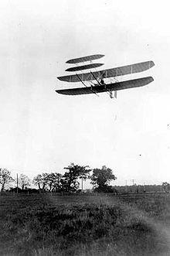
Wright Flyer No. 3
New machine except for 1904 engine
Separate control for rear rudder
Orville near fatal accident - Improvements
Enlarged forward elevator and rear rudder
Place several feet farther away from
wings
Improved stability and control
49 flight in 1905
Many 17 – 38 minutes in length
Most ended because fuel ran out

Slide 23
Non-Flying
No flights in 1906 and 1907
No patent
Offered to sell flying machine
European skeptics

Slide 24
Refurbished Wright Flyer No. 3
US Army Signal Corps (Dec 1907)
Invited proposals
41 bids received
Wright Brothers won contract
1908 – Contract with French company

Slide 25
Refurbished Wright Flyer No. 3
US Army Signal Corps
Contract required carrying passenger
Modified 1905 Flyer
Seat for pilot and one passenger
Hand levers replace hip cradle
Charles Furnas (mechanic) first passenger
Model A for Army
Crashed 17 Sep 1908
Lt Selfridge first airplane fatality
Orville sustained serious injury

Slide 26
European Tour
European skepticism
Wilbur Wright toured Europe
Official public demonstrations
Catapulted brothers to world fame
Edith Berg, first American woman passenger
Won Michelin Cup
2 hours 18 minutes 33 seconds
Trained pilots who purchased airplanes

Slide 27
Military Sales
2 revised Model B’s
Added wheels
Moved elevator from front to rear
Easier to control due to higher speeds
30 HP and top speed of 42 MPH
Model C Triad Scout
50 HP and top speed of 48 MPH
Army questioned safety and design
Ended use of “pusher” type propellers
Model D Scout
50 HP and top speed of 67 MPH

Slide 28
Wright Company
Wilbur - president
Orville – vice-president
Constructed factory in Dayton
Production reached 2 airplanes per month
Trained 115 pilots by 1916
Hap Arnold was trained there

Slide 29
Later Years
Wilbur - died in 1912 (45)
Typhoid
Orville
Sold manufacturing/patent rights in 1915
1944 – flew on Lockheed Constellation
Howard Hughes pilot
“Wingspan was longer than the distance of his first flight”
Died 30 Jan 1948

