Slide 1
Early Flight
1904 – 1914
“Passion for Wings”
Notes:
Prior to World War I, aviation consisted of biplanes and experimental aircraft, balloons, dirigibles, and airships. Wilbur and Orville Wright made their historic flight on 17 Dec 1903. Airplane development continued to develop in America and Europe. In 1905, the Wright brothers were in the forefront of airplane design. They retired from flying for three years while they were in litigation with airplane patents. Octave Chanute inspired some of the European efforts for airplane development.

Slide 2
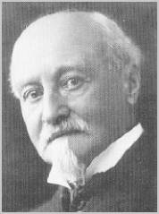
Octave Chanute
Successful engineer
Authority in iron bridges
Truss construction techniques
Wood preservation
Retired early
Aviation Interest
Notes:
http://invention.psychology.msstate.edu/
Octave Chanute - this Chicago engineer was the 'elder statesman' of aeronautical experiments in 1900. His glider experiments at Miller Beach in 1896 produced the most influential and significant glider of the pre-Wright era.
Octave Chanute was a successful engineer who took up the invention of the airplane as a hobby following his early retirement. His book Progress in Flying Machines was a useful compendium of information about heavier-than-air flight that was widely read and respected. Chanute sponsored the construction of several craft -- the most successful was the Herring/Chanute biplane glider that formed the basis of the Wright biplane design. Chanute was also a tireless international promoter of airplane development, sharing news from around the globe with interested inventors. His correspondence and association with the Wright brothers played an important role in their ultimate success, perhaps more for his encouragement than for technical matters. He visited the Wright camp at Kitty Hawk in 1902 and 1903, and saw the powered flyer take to the air in 1904. Octave Chanute (pronounced "sha-noot") was born in Paris and came to the United States as a child. He became an outstanding civil engineer and respected scientist who lent his talents to furthering human transportation. He spent most of his adult life as an engineer in the railroad industry, but later gained international fame in the study of aeronautics. He published Progress in Flying Machines in New York in 1894, which summarized and thoroughly analyzed the technical accomplishments of the world's aviation pioneers up to that time. The book became a classic and a guidebook for the efforts of many would-be aviators around the world, including the Wright brothers. Chanute designed and oversaw the construction of several important railroads in this country, as well as the first railroad bridge over the Missouri River and the Union stockyards in Kansas City and Chicago. He had a wide variety of interests and specialties, being an authority in iron bridges, truss construction techniques, and wood preservation. The Wright brothers acknowledged Chanute's key role as a mentor, saying that his research and continual inspiration paved the way for their success. Chanute corresponded with them for many years and even visited their camp at Kitty Hawk during their flight experiments. (To see photographs of the Wright brothers' encampment taken by Chanute himself in 1901 and 1902, visit the Library of Congress online exhibit The Recovered Legacy: Images of the Wright Brothers at Kill Devil Hills.) Chanute was also instrumental in the revival of flight research in Europe in the early twentieth century. His lectures in Paris following the successful flight of the Wright Flyer in the United States served to rekindle the waning interest in flight among many European engineers. Although he never flew, Octave Chanute spent a great deal of his life inspiring others to do so. It has been said that "he caused people to act and things to happen by what he did, what he wrote, what he said." Just months before his death he was still at it, publishing a final treatise, "Recent Progress in Aviation." "Let us hope that the advent of a successful flying machine, now only dimly foreseen and nevertheless thought to be possible, will bring nothing but good into the world; that it shall abridge distance, make all parts of the globe accessible, bring men into closer relation with each other, advance civilization, and hasten the promised era in which there shall be nothing but peace and goodwill among all men." Octave Chanute Progress in Flying Machines 1894
Cody, Samuel Franklin (1861-1913)

Slide 3
Octave Chanute
Progress in Flying Machines
Written in 1894
Widely read and respected
Guidebook for others
Constructed several craft
Herring/Chanute biplane glider
Basis of Wright biplane design
Never flew
Inspired others to fly
Notes:
http://invention.psychology.msstate.edu/
Octave Chanute - this Chicago engineer was the 'elder statesman' of aeronautical experiments in 1900. His glider experiments at Miller Beach in 1896 produced the most influential and significant glider of the pre-Wright era.
Octave Chanute was a successful engineer who took up the invention of the airplane as a hobby following his early retirement. His book Progress in Flying Machines was a useful compendium of information about heavier-than-air flight that was widely read and respected. Chanute sponsored the construction of several craft -- the most successful was the Herring/Chanute biplane glider that formed the basis of the Wright biplane design. Chanute was also a tireless international promoter of airplane development, sharing news from around the globe with interested inventors. His correspondence and association with the Wright brothers played an important role in their ultimate success, perhaps more for his encouragement than for technical matters. He visited the Wright camp at Kitty Hawk in 1902 and 1903, and saw the powered flyer take to the air in 1904. Octave Chanute (pronounced "sha-noot") was born in Paris and came to the United States as a child. He became an outstanding civil engineer and respected scientist who lent his talents to furthering human transportation. He spent most of his adult life as an engineer in the railroad industry, but later gained international fame in the study of aeronautics. He published Progress in Flying Machines in New York in 1894, which summarized and thoroughly analyzed the technical accomplishments of the world's aviation pioneers up to that time. The book became a classic and a guidebook for the efforts of many would-be aviators around the world, including the Wright brothers. Chanute designed and oversaw the construction of several important railroads in this country, as well as the first railroad bridge over the Missouri River and the Union stockyards in Kansas City and Chicago. He had a wide variety of interests and specialties, being an authority in iron bridges, truss construction techniques, and wood preservation. The Wright brothers acknowledged Chanute's key role as a mentor, saying that his research and continual inspiration paved the way for their success. Chanute corresponded with them for many years and even visited their camp at Kitty Hawk during their flight experiments. (To see photographs of the Wright brothers' encampment taken by Chanute himself in 1901 and 1902, visit the Library of Congress online exhibit The Recovered Legacy: Images of the Wright Brothers at Kill Devil Hills.) Chanute was also instrumental in the revival of flight research in Europe in the early twentieth century. His lectures in Paris following the successful flight of the Wright Flyer in the United States served to rekindle the waning interest in flight among many European engineers. Although he never flew, Octave Chanute spent a great deal of his life inspiring others to do so. It has been said that "he caused people to act and things to happen by what he did, what he wrote, what he said." Just months before his death he was still at it, publishing a final treatise, "Recent Progress in Aviation." "Let us hope that the advent of a successful flying machine, now only dimly foreseen and nevertheless thought to be possible, will bring nothing but good into the world; that it shall abridge distance, make all parts of the globe accessible, bring men into closer relation with each other, advance civilization, and hasten the promised era in which there shall be nothing but peace and goodwill among all men." Octave Chanute Progress in Flying Machines 1894
Cody, Samuel Franklin (1861-1913)

Slide 4
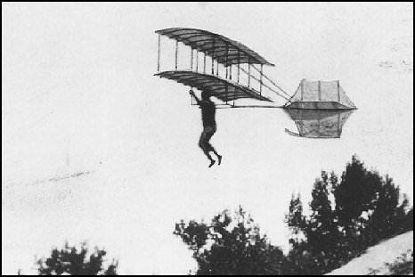
Chanute-Herring Two Surfaced Glider
Notes:
The glider that the Wright brothers referred to as the 'Chanute double decker' was built in July and August of 1896 between the two visits that summer to the Indiana dunes. It's trussed bi-plane design would be the model for the Wright brothers in constructing their gliders and eventually their first airplane. First flown at the Dune Park location as a tri-plane on Saturday, August 29th, it was found to be too unwieldy. On Monday the 31st the lower of the three wings was removed and some successful glides were made with the machine. A week of bad weather prevented glides until Friday, when 10 or 12 'beautiful' glides were made, the longest 253 feet.
Pictures of this glider were often confused with the Herring-Arnot glider that was flown the following summer. There were more, and better, pictures taken of that very similar glider and they were often used to illustrate the flights of the Chanute-Herring glider.
The following images were of the 'original' Chanute-Herring glider. The formal, posed picture shows the side bays which were evidently removed, for they never appear in the flight photos and no mention is made of them in the diary. http://www.aeromuseum.org/newsCalendar.html

Slide 5
Octave Chanute
Wright Brothers
Visited Kitty Hawk in 1902 & 1903
Mentor
Corresponded for years
Continual inspiration paved way for their success
Notes:
http://invention.psychology.msstate.edu/
Octave Chanute - this Chicago engineer was the 'elder statesman' of aeronautical experiments in 1900. His glider experiments at Miller Beach in 1896 produced the most influential and significant glider of the pre-Wright era.
Octave Chanute was a successful engineer who took up the invention of the airplane as a hobby following his early retirement. His book Progress in Flying Machines was a useful compendium of information about heavier-than-air flight that was widely read and respected. Chanute sponsored the construction of several craft -- the most successful was the Herring/Chanute biplane glider that formed the basis of the Wright biplane design. Chanute was also a tireless international promoter of airplane development, sharing news from around the globe with interested inventors. His correspondence and association with the Wright brothers played an important role in their ultimate success, perhaps more for his encouragement than for technical matters. He visited the Wright camp at Kitty Hawk in 1902 and 1903, and saw the powered flyer take to the air in 1904. Octave Chanute (pronounced "sha-noot") was born in Paris and came to the United States as a child. He became an outstanding civil engineer and respected scientist who lent his talents to furthering human transportation. He spent most of his adult life as an engineer in the railroad industry, but later gained international fame in the study of aeronautics. He published Progress in Flying Machines in New York in 1894, which summarized and thoroughly analyzed the technical accomplishments of the world's aviation pioneers up to that time. The book became a classic and a guidebook for the efforts of many would-be aviators around the world, including the Wright brothers. Chanute designed and oversaw the construction of several important railroads in this country, as well as the first railroad bridge over the Missouri River and the Union stockyards in Kansas City and Chicago. He had a wide variety of interests and specialties, being an authority in iron bridges, truss construction techniques, and wood preservation. The Wright brothers acknowledged Chanute's key role as a mentor, saying that his research and continual inspiration paved the way for their success. Chanute corresponded with them for many years and even visited their camp at Kitty Hawk during their flight experiments. (To see photographs of the Wright brothers' encampment taken by Chanute himself in 1901 and 1902, visit the Library of Congress online exhibit The Recovered Legacy: Images of the Wright Brothers at Kill Devil Hills.) Chanute was also instrumental in the revival of flight research in Europe in the early twentieth century. His lectures in Paris following the successful flight of the Wright Flyer in the United States served to rekindle the waning interest in flight among many European engineers. Although he never flew, Octave Chanute spent a great deal of his life inspiring others to do so. It has been said that "he caused people to act and things to happen by what he did, what he wrote, what he said." Just months before his death he was still at it, publishing a final treatise, "Recent Progress in Aviation." "Let us hope that the advent of a successful flying machine, now only dimly foreseen and nevertheless thought to be possible, will bring nothing but good into the world; that it shall abridge distance, make all parts of the globe accessible, bring men into closer relation with each other, advance civilization, and hasten the promised era in which there shall be nothing but peace and goodwill among all men." Octave Chanute Progress in Flying Machines 1894
Cody, Samuel Franklin (1861-1913)

Slide 6
Octave Chanute
European Revival
International promoter of airplane development
Shared news around globe
Paris lectures
Wright successes
Rekindled interest in flight among many European engineers
Notes:
http://invention.psychology.msstate.edu/
Octave Chanute - this Chicago engineer was the 'elder statesman' of aeronautical experiments in 1900. His glider experiments at Miller Beach in 1896 produced the most influential and significant glider of the pre-Wright era.
Octave Chanute was a successful engineer who took up the invention of the airplane as a hobby following his early retirement. His book Progress in Flying Machines was a useful compendium of information about heavier-than-air flight that was widely read and respected. Chanute sponsored the construction of several craft -- the most successful was the Herring/Chanute biplane glider that formed the basis of the Wright biplane design. Chanute was also a tireless international promoter of airplane development, sharing news from around the globe with interested inventors. His correspondence and association with the Wright brothers played an important role in their ultimate success, perhaps more for his encouragement than for technical matters. He visited the Wright camp at Kitty Hawk in 1902 and 1903, and saw the powered flyer take to the air in 1904. Octave Chanute (pronounced "sha-noot") was born in Paris and came to the United States as a child. He became an outstanding civil engineer and respected scientist who lent his talents to furthering human transportation. He spent most of his adult life as an engineer in the railroad industry, but later gained international fame in the study of aeronautics. He published Progress in Flying Machines in New York in 1894, which summarized and thoroughly analyzed the technical accomplishments of the world's aviation pioneers up to that time. The book became a classic and a guidebook for the efforts of many would-be aviators around the world, including the Wright brothers. Chanute designed and oversaw the construction of several important railroads in this country, as well as the first railroad bridge over the Missouri River and the Union stockyards in Kansas City and Chicago. He had a wide variety of interests and specialties, being an authority in iron bridges, truss construction techniques, and wood preservation. The Wright brothers acknowledged Chanute's key role as a mentor, saying that his research and continual inspiration paved the way for their success. Chanute corresponded with them for many years and even visited their camp at Kitty Hawk during their flight experiments. (To see photographs of the Wright brothers' encampment taken by Chanute himself in 1901 and 1902, visit the Library of Congress online exhibit The Recovered Legacy: Images of the Wright Brothers at Kill Devil Hills.) Chanute was also instrumental in the revival of flight research in Europe in the early twentieth century. His lectures in Paris following the successful flight of the Wright Flyer in the United States served to rekindle the waning interest in flight among many European engineers. Although he never flew, Octave Chanute spent a great deal of his life inspiring others to do so. It has been said that "he caused people to act and things to happen by what he did, what he wrote, what he said." Just months before his death he was still at it, publishing a final treatise, "Recent Progress in Aviation." "Let us hope that the advent of a successful flying machine, now only dimly foreseen and nevertheless thought to be possible, will bring nothing but good into the world; that it shall abridge distance, make all parts of the globe accessible, bring men into closer relation with each other, advance civilization, and hasten the promised era in which there shall be nothing but peace and goodwill among all men." Octave Chanute Progress in Flying Machines 1894
Cody, Samuel Franklin (1861-1913)

Slide 7
Robert Esnault-Pelterie
Tried to reproduce 1902 Wright glider
Failed
No specifications
No experience of gliding flights
No theoretical understanding of flight
European skepticism
Devised own glider using ailerons
Notes:
http://invention.psychology.msstate.edu/
Octave Chanute - this Chicago engineer was the 'elder statesman' of aeronautical experiments in 1900. His glider experiments at Miller Beach in 1896 produced the most influential and significant glider of the pre-Wright era.
Octave Chanute was a successful engineer who took up the invention of the airplane as a hobby following his early retirement. His book Progress in Flying Machines was a useful compendium of information about heavier-than-air flight that was widely read and respected. Chanute sponsored the construction of several craft -- the most successful was the Herring/Chanute biplane glider that formed the basis of the Wright biplane design. Chanute was also a tireless international promoter of airplane development, sharing news from around the globe with interested inventors. His correspondence and association with the Wright brothers played an important role in their ultimate success, perhaps more for his encouragement than for technical matters. He visited the Wright camp at Kitty Hawk in 1902 and 1903, and saw the powered flyer take to the air in 1904. Octave Chanute (pronounced "sha-noot") was born in Paris and came to the United States as a child. He became an outstanding civil engineer and respected scientist who lent his talents to furthering human transportation. He spent most of his adult life as an engineer in the railroad industry, but later gained international fame in the study of aeronautics. He published Progress in Flying Machines in New York in 1894, which summarized and thoroughly analyzed the technical accomplishments of the world's aviation pioneers up to that time. The book became a classic and a guidebook for the efforts of many would-be aviators around the world, including the Wright brothers. Chanute designed and oversaw the construction of several important railroads in this country, as well as the first railroad bridge over the Missouri River and the Union stockyards in Kansas City and Chicago. He had a wide variety of interests and specialties, being an authority in iron bridges, truss construction techniques, and wood preservation. The Wright brothers acknowledged Chanute's key role as a mentor, saying that his research and continual inspiration paved the way for their success. Chanute corresponded with them for many years and even visited their camp at Kitty Hawk during their flight experiments. (To see photographs of the Wright brothers' encampment taken by Chanute himself in 1901 and 1902, visit the Library of Congress online exhibit The Recovered Legacy: Images of the Wright Brothers at Kill Devil Hills.) Chanute was also instrumental in the revival of flight research in Europe in the early twentieth century. His lectures in Paris following the successful flight of the Wright Flyer in the United States served to rekindle the waning interest in flight among many European engineers. Although he never flew, Octave Chanute spent a great deal of his life inspiring others to do so. It has been said that "he caused people to act and things to happen by what he did, what he wrote, what he said." Just months before his death he was still at it, publishing a final treatise, "Recent Progress in Aviation." "Let us hope that the advent of a successful flying machine, now only dimly foreseen and nevertheless thought to be possible, will bring nothing but good into the world; that it shall abridge distance, make all parts of the globe accessible, bring men into closer relation with each other, advance civilization, and hasten the promised era in which there shall be nothing but peace and goodwill among all men." Octave Chanute Progress in Flying Machines 1894
Cody, Samuel Franklin (1861-1913)

Slide 8
Gabriel Voisin
Syndicat d’Aviation
First company organized to build aircraft
Produced gliders
Teamed with Louis Bleriot
Made powered aircraft
Unsuccessful
Devised boxkite-like features
Notes:
http://invention.psychology.msstate.edu/
Octave Chanute - this Chicago engineer was the 'elder statesman' of aeronautical experiments in 1900. His glider experiments at Miller Beach in 1896 produced the most influential and significant glider of the pre-Wright era.
Octave Chanute was a successful engineer who took up the invention of the airplane as a hobby following his early retirement. His book Progress in Flying Machines was a useful compendium of information about heavier-than-air flight that was widely read and respected. Chanute sponsored the construction of several craft -- the most successful was the Herring/Chanute biplane glider that formed the basis of the Wright biplane design. Chanute was also a tireless international promoter of airplane development, sharing news from around the globe with interested inventors. His correspondence and association with the Wright brothers played an important role in their ultimate success, perhaps more for his encouragement than for technical matters. He visited the Wright camp at Kitty Hawk in 1902 and 1903, and saw the powered flyer take to the air in 1904. Octave Chanute (pronounced "sha-noot") was born in Paris and came to the United States as a child. He became an outstanding civil engineer and respected scientist who lent his talents to furthering human transportation. He spent most of his adult life as an engineer in the railroad industry, but later gained international fame in the study of aeronautics. He published Progress in Flying Machines in New York in 1894, which summarized and thoroughly analyzed the technical accomplishments of the world's aviation pioneers up to that time. The book became a classic and a guidebook for the efforts of many would-be aviators around the world, including the Wright brothers. Chanute designed and oversaw the construction of several important railroads in this country, as well as the first railroad bridge over the Missouri River and the Union stockyards in Kansas City and Chicago. He had a wide variety of interests and specialties, being an authority in iron bridges, truss construction techniques, and wood preservation. The Wright brothers acknowledged Chanute's key role as a mentor, saying that his research and continual inspiration paved the way for their success. Chanute corresponded with them for many years and even visited their camp at Kitty Hawk during their flight experiments. (To see photographs of the Wright brothers' encampment taken by Chanute himself in 1901 and 1902, visit the Library of Congress online exhibit The Recovered Legacy: Images of the Wright Brothers at Kill Devil Hills.) Chanute was also instrumental in the revival of flight research in Europe in the early twentieth century. His lectures in Paris following the successful flight of the Wright Flyer in the United States served to rekindle the waning interest in flight among many European engineers. Although he never flew, Octave Chanute spent a great deal of his life inspiring others to do so. It has been said that "he caused people to act and things to happen by what he did, what he wrote, what he said." Just months before his death he was still at it, publishing a final treatise, "Recent Progress in Aviation." "Let us hope that the advent of a successful flying machine, now only dimly foreseen and nevertheless thought to be possible, will bring nothing but good into the world; that it shall abridge distance, make all parts of the globe accessible, bring men into closer relation with each other, advance civilization, and hasten the promised era in which there shall be nothing but peace and goodwill among all men." Octave Chanute Progress in Flying Machines 1894
Cody, Samuel Franklin (1861-1913)

Slide 9
Alberto Santos-Dumont
1906 - Designed biplane (boxkite-like wing)
Hired Voisin to build
Flight testing in September
Hanging from Dumont’s dirigible No.14
50-horsepower Antoinette motor
October – won Archdeacon Prize
First flight of at least 25 meters
Notes:
The 14-bis, also known as Oiseau de proie (French for "bird of prey"), was an early fixed-wing aircraft designed and built by Brazilian inventor Alberto Santos-Dumont. On October 23, 1906, in Bagatelle, France, it performed the first publicly witnessed, unaided take-off by a heavier-than-air aircraft. Earlier flights, such as that made by the Wright Brothers had required favorable wind directions, catapults or other such devices to take off.
Specifications (14-bis)
General characteristics
Crew: one pilot
Capacity: one
Length: 9.70 m (31 ft 10 in)
Wingspan: 11.20 m (36 ft 9 in)
Height: 3.40 m (11 ft 2 in)
Wing area: 52 m² (560 ft²)
Empty weight: ? ()
Loaded weight: 210 kg (462 lb)
Powerplant: 1× AntoinetteV-16 , 37 kW (50 hp)24 hp
Performance
Maximum speed: 32 km/h to 43 km/s (25 mph/1.1.)
Range: >220 m (demonstrated) (>720 ft)
Wing loading: 5.7 kg/m² (1.2 lb/ft²)
Power/mass: 0.12 kW/kg (0.075 hp/lb)
http://en.wikipedia.org/wiki/Santos-Dumont_14-bis#Specifications_.2814-bis.29

Slide 10
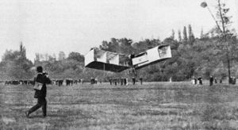
Alberto Santos-Dumont
First official recognized flight in Europe
12 November 1906
Several flights
Longest – 21 seconds /722 feet
Notes:
The 14-bis, also known as Oiseau de proie (French for "bird of prey"), was an early fixed-wing aircraft designed and built by Brazilian inventor Alberto Santos-Dumont. On October 23, 1906, in Bagatelle, France, it performed the first publicly witnessed, unaided take-off by a heavier-than-air aircraft. Earlier flights, such as that made by the Wright Brothers had required favorable wind directions, catapults or other such devices to take off.
Specifications (14-bis)
General characteristics
Crew: one pilot
Capacity: one
Length: 9.70 m (31 ft 10 in)
Wingspan: 11.20 m (36 ft 9 in)
Height: 3.40 m (11 ft 2 in)
Wing area: 52 m² (560 ft²)
Empty weight: ? ()
Loaded weight: 210 kg (462 lb)
Powerplant: 1× AntoinetteV-16 , 37 kW (50 hp)24 hp
Performance
Maximum speed: 32 km/h to 43 km/s (25 mph/1.1.)
Range: >220 m (demonstrated) (>720 ft)
Wing loading: 5.7 kg/m² (1.2 lb/ft²)
Power/mass: 0.12 kW/kg (0.075 hp/lb)
http://en.wikipedia.org/wiki/Santos-Dumont_14-bis#Specifications_.2814-bis.29

Slide 11
Alberto Santos-Dumont
French Aero Club prize
First flight over 100 meters
Official Recognition
First manned powered flight in Europe
Recognized as:
First person to fly an airplane
Honored for two years
Wilbur Wright European tour
Notes:
The 14-bis, also known as Oiseau de proie (French for "bird of prey"), was an early fixed-wing aircraft designed and built by Brazilian inventor Alberto Santos-Dumont. On October 23, 1906, in Bagatelle, France, it performed the first publicly witnessed, unaided take-off by a heavier-than-air aircraft. Earlier flights, such as that made by the Wright Brothers had required favorable wind directions, catapults or other such devices to take off.
Specifications (14-bis)
General characteristics
Crew: one pilot
Capacity: one
Length: 9.70 m (31 ft 10 in)
Wingspan: 11.20 m (36 ft 9 in)
Height: 3.40 m (11 ft 2 in)
Wing area: 52 m² (560 ft²)
Empty weight: ? ()
Loaded weight: 210 kg (462 lb)
Powerplant: 1× AntoinetteV-16 , 37 kW (50 hp)24 hp
Performance
Maximum speed: 32 km/h to 43 km/s (25 mph/1.1.)
Range: >220 m (demonstrated) (>720 ft)
Wing loading: 5.7 kg/m² (1.2 lb/ft²)
Power/mass: 0.12 kW/kg (0.075 hp/lb)
http://en.wikipedia.org/wiki/Santos-Dumont_14-bis#Specifications_.2814-bis.29

Slide 12
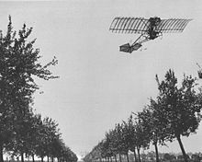
Alberto Santos-Dumont
Demoiselle monoplane
Specially reinforce bamboo boom
Tail unit functioned as elevator and rudder

Slide 13
Airplane Production
Aviators made own aircraft
French turned production into business
Gabriel Voisin
Influenced by Wright Brothers
Pusher planes
Produced about 20 by WWI
Notes:
Henri Farman's Aeroplane at Ghent, 1908 Collection of Jean-Pierre Lauwers
Farman Type 40 (Engine Renault 130 hp) of the Aéronautique Militaire seen at Houtem in the Spring 1915.

Slide 14
Airplane Production
Henry Farman – Englishman
Ordered airplane from Voisin
Added ailerons/modified tail
1908 – Grand Prix d’ Aviation prize
50,000 francs
Made first flight around circular route
Ordered second airplane from Voisin
Voisin sold to someone else
Established own production company
Notes:
Henri Farman's Aeroplane at Ghent, 1908 Collection of Jean-Pierre Lauwers
Farman Type 40 (Engine Renault 130 hp) of the Aéronautique Militaire seen at Houtem in the Spring 1915.

Slide 15
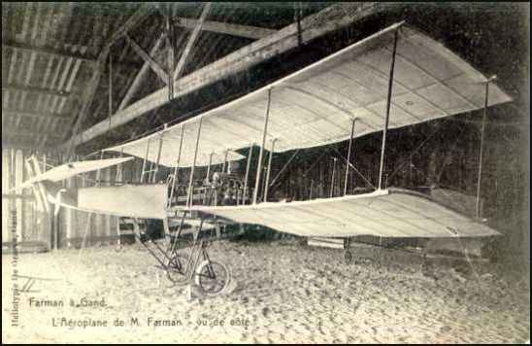
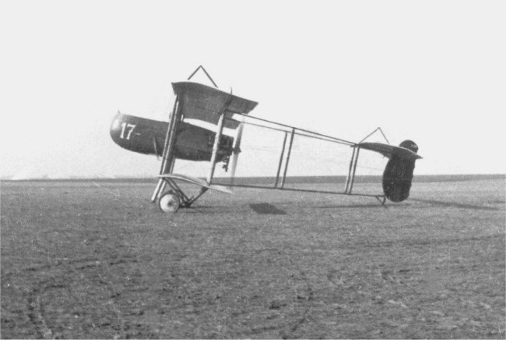
Henry Farman
Produced biplanes
Rheims International Air Meet
First pilot to fly over 100 miles
111.8 Miles – Closed circuit
Top Prize winner
Farman Type 40
Notes:
Henri Farman's Aeroplane at Ghent, 1908 Collection of Jean-Pierre Lauwers
Farman Type 40 (Engine Renault 130 hp) of the Aéronautique Militaire seen at Houtem in the Spring 1915.

Slide 16
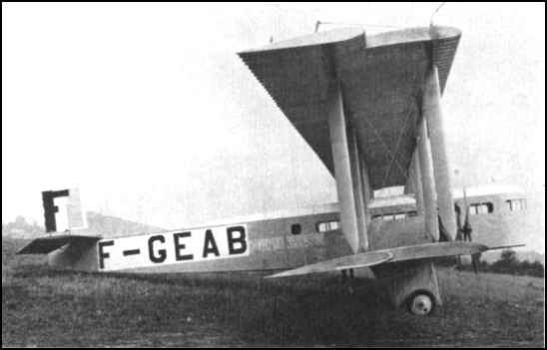
Henry Farman
First long-distance passenger airliner
Paris – London flights
8 February 1919
Farman Goliath
Notes:
Henri Farman's Aeroplane at Ghent, 1908 Collection of Jean-Pierre Lauwers
Farman Goliath

Slide 17
Short Brothers
Experienced ballooners
First airplane manufacturing company
Britain
Obtained Wright license (6 aircraft)
First to produce airplanes in series
Designed own aircraft
Notes:
The American and European aviation industries began to develop within a few years of each other, but Europe took the first formal steps to establish dedicated aircraft companies in the early decades of the 20th century. During this time, there was a shift from aircraft designers, builders, and pilots all being the same people to having entrepreneurs who ran the business and built the planes and others who flew them.
In England, the Short brothers—Horace, Albert, and Hugh, three experienced balloon-makers, established the first British airplane manufacturing company in 1908. After two unsuccessful planes, Albert obtained a license from Wilbur Wright in February 1909 to manufacture six Wright airplanes in Britain. This order made the Short company the first to produce a series of planes, rather than one of a model.
The brothers went on to design and build their own aircraft. Horace designed their first successful airplane, the Short biplane No. 2. In 1913, they produced a seaplane with folding wings that allowed the plane to be parked on a ship. In 1915, the Seaplane 184 was the first aircraft to sink a ship with a torpedo, when it sank a Turkish merchant ship in the Dardanelles. This bomber saw service until better heavy bombers came along and the Short was reassigned to reconnaissance duties. They also built a small number of land-based bombers and what some claim to be the first twin-engine plane to fly—the Triple-Twin biplane.

Slide 18
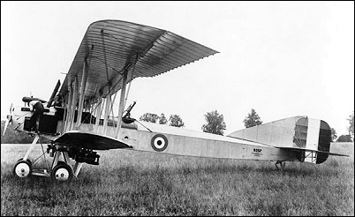
Short Brothers
Short bi-plane #2
Short Bomber 1915
Notes:
The American and European aviation industries began to develop within a few years of each other, but Europe took the first formal steps to establish dedicated aircraft companies in the early decades of the 20th century. During this time, there was a shift from aircraft designers, builders, and pilots all being the same people to having entrepreneurs who ran the business and built the planes and others who flew them.
In England, the Short brothers—Horace, Albert, and Hugh, three experienced balloon-makers, established the first British airplane manufacturing company in 1908. After two unsuccessful planes, Albert obtained a license from Wilbur Wright in February 1909 to manufacture six Wright airplanes in Britain. This order made the Short company the first to produce a series of planes, rather than one of a model.
The brothers went on to design and build their own aircraft. Horace designed their first successful airplane, the Short biplane No. 2. In 1913, they produced a seaplane with folding wings that allowed the plane to be parked on a ship. In 1915, the Seaplane 184 was the first aircraft to sink a ship with a torpedo, when it sank a Turkish merchant ship in the Dardanelles. This bomber saw service until better heavy bombers came along and the Short was reassigned to reconnaissance duties. They also built a small number of land-based bombers and what some claim to be the first twin-engine plane to fly—the Triple-Twin biplane.

Slide 19
Louis Bleriot
1909 – first successful airplane produced
Bleriot XI
Monoplane
Three-wheel undercarriage
Pylons supporting wings
Rectangular fuselage
Small rudder and rear elevator
Used wing warping
Notes:
Louis Blériot (July 1, 1872 – August 2, 1936) was a French inventor and engineer. He performed the first flight over a large body of water in a heavier-than-air craft. Born in Cambrai, Louis Blériot studied engineering at the École Centrale Paris. His interest in aviation manifested itself when, in 1900, he built an ornithopter, a type of early aircraft designed to use wing-flapping to achieve flight.
Blériot and collaborator Gabriel Voisin formed the Blériot-Voisin Company. Active between 1903 and 1906, the company developed several aircraft designs. After years of honing his piloting skills, Blériot decided to go after the coveted thousand-pound prize offered by the London Daily Mail for a successful crossing of the English Channel. On July 25, 1909 he flew the twenty-two statute miles (35 km) from Les Barraques (near Calais) to Dover in his Blériot XI. The trip took forty minutes.
Afterwards, Blériot became a successful businessman, with his Société Pour Aviation et ses Derives (better known as SPAD) manufacturing thousands of Allied planes in World War I. Wing warping was an early system for controlling the roll of an aeroplane while flying. The technique, used and patented by the Wright brothers, used a system of pulleys and cables to twist the trailing edges of the wings in opposite directions. In many respects, this approach is similar to that used to trim the performance of a paper aeroplane by curling the paper at the back of its wings.
In practice, wing warping is difficult to control and potentially dangerous. Around 1915, wing warping began to be superseded by ailerons in practical aircraft designs. The history of the invention of ailerons is controversial, however. The plane would gain immortality on July 25, 1909 when Louis Blériot successfully crossed the Channel from Calais to Dover in 36.5 minutes. For several days bad weather grounded Blériot and his opponent Hubert Latham. On the morning of July 25, 1909, Blériot awoke (albeit in a bad mood) to conditions fair enough to fly in. When Blériot took off, Latham's camp was still quiet...Latham had overslept. Fighting fog and bad weather Blériot did not even have a navigational instrument as simple as a compass to guide his crossing. It is said that the Anzani engine made the flight only with the aid of a brief rainshower to cool it off. Letting the aircraft guide itself, Blériot eventually saw the gray line of the English coast. Approaching closer and closer he spotted a French reporter waving the French flag marking the landing spot. Louis made a very rough landing but walked away, winning the £1000 prize awarded by the London Daily

Slide 20
Louis Bleriot
London Daily Mail prize
Fly airplane across English Channel
25 May 1909
36 minutes 30 seconds
Flew demonstration flights
Crash
Romania – December 1909
32nd crash
Notes:
Louis Blériot (July 1, 1872 – August 2, 1936) was a French inventor and engineer. He performed the first flight over a large body of water in a heavier-than-air craft. Born in Cambrai, Louis Blériot studied engineering at the École Centrale Paris. His interest in aviation manifested itself when, in 1900, he built an ornithopter, a type of early aircraft designed to use wing-flapping to achieve flight.
Blériot and collaborator Gabriel Voisin formed the Blériot-Voisin Company. Active between 1903 and 1906, the company developed several aircraft designs. After years of honing his piloting skills, Blériot decided to go after the coveted thousand-pound prize offered by the London Daily Mail for a successful crossing of the English Channel. On July 25, 1909 he flew the twenty-two statute miles (35 km) from Les Barraques (near Calais) to Dover in his Blériot XI. The trip took forty minutes.
Afterwards, Blériot became a successful businessman, with his Société Pour Aviation et ses Derives (better known as SPAD) manufacturing thousands of Allied planes in World War I. Wing warping was an early system for controlling the roll of an aeroplane while flying. The technique, used and patented by the Wright brothers, used a system of pulleys and cables to twist the trailing edges of the wings in opposite directions. In many respects, this approach is similar to that used to trim the performance of a paper aeroplane by curling the paper at the back of its wings.
In practice, wing warping is difficult to control and potentially dangerous. Around 1915, wing warping began to be superseded by ailerons in practical aircraft designs. The history of the invention of ailerons is controversial, however. The plane would gain immortality on July 25, 1909 when Louis Blériot successfully crossed the Channel from Calais to Dover in 36.5 minutes. For several days bad weather grounded Blériot and his opponent Hubert Latham. On the morning of July 25, 1909, Blériot awoke (albeit in a bad mood) to conditions fair enough to fly in. When Blériot took off, Latham's camp was still quiet...Latham had overslept. Fighting fog and bad weather Blériot did not even have a navigational instrument as simple as a compass to guide his crossing. It is said that the Anzani engine made the flight only with the aid of a brief rainshower to cool it off. Letting the aircraft guide itself, Blériot eventually saw the gray line of the English coast. Approaching closer and closer he spotted a French reporter waving the French flag marking the landing spot. Louis made a very rough landing but walked away, winning the £1000 prize awarded by the London Daily

Slide 21
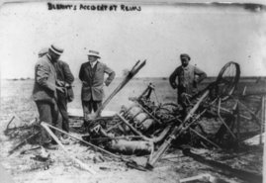
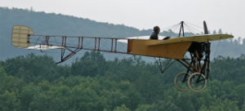
Louis Bleriot
Blériot XI
Wreckage of Blériot's plane, Air Meet, August 1909
Notes:
Louis Blériot (July 1, 1872 – August 2, 1936) was a French inventor and engineer. He performed the first flight over a large body of water in a heavier-than-air craft. Born in Cambrai, Louis Blériot studied engineering at the École Centrale Paris. His interest in aviation manifested itself when, in 1900, he built an ornithopter, a type of early aircraft designed to use wing-flapping to achieve flight.
Blériot and collaborator Gabriel Voisin formed the Blériot-Voisin Company. Active between 1903 and 1906, the company developed several aircraft designs. After years of honing his piloting skills, Blériot decided to go after the coveted thousand-pound prize offered by the London Daily Mail for a successful crossing of the English Channel. On July 25, 1909 he flew the twenty-two statute miles (35 km) from Les Barraques (near Calais) to Dover in his Blériot XI. The trip took forty minutes.
Afterwards, Blériot became a successful businessman, with his Société Pour Aviation et ses Derives (better known as SPAD) manufacturing thousands of Allied planes in World War I. Wing warping was an early system for controlling the roll of an aeroplane while flying. The technique, used and patented by the Wright brothers, used a system of pulleys and cables to twist the trailing edges of the wings in opposite directions. In many respects, this approach is similar to that used to trim the performance of a paper aeroplane by curling the paper at the back of its wings.
In practice, wing warping is difficult to control and potentially dangerous. Around 1915, wing warping began to be superseded by ailerons in practical aircraft designs. The history of the invention of ailerons is controversial, however. The plane would gain immortality on July 25, 1909 when Louis Blériot successfully crossed the Channel from Calais to Dover in 36.5 minutes. For several days bad weather grounded Blériot and his opponent Hubert Latham. On the morning of July 25, 1909, Blériot awoke (albeit in a bad mood) to conditions fair enough to fly in. When Blériot took off, Latham's camp was still quiet...Latham had overslept. Fighting fog and bad weather Blériot did not even have a navigational instrument as simple as a compass to guide his crossing. It is said that the Anzani engine made the flight only with the aid of a brief rainshower to cool it off. Letting the aircraft guide itself, Blériot eventually saw the gray line of the English coast. Approaching closer and closer he spotted a French reporter waving the French flag marking the landing spot. Louis made a very rough landing but walked away, winning the £1000 prize awarded by the London Daily

Slide 22
Igor Sikorsky
Russian born
Flying machine lifted by the propeller
Built two helicopters (1909/1910)
Neither flew
Attention turned to airplanes
Taught himself to fly
S-5
Rudders controlled by pedals
Single wheel for ailerons and elevator
Notes:
Born in Kiev, Russia, on May 25, 1889, Igor (Ivan) Sikorsky developed an early interest in aviation. He learned of the Wright brothers during a trip to Germany as a youth and also became familiar with the work of Count Ferdinand von Zeppelin.
He graduated from the Petrograd Naval College and studied engineering in Paris and Kiev. In 1909, he returned to Paris, then the aeronautical center of Europe, to learn about the fledgling science. While there, he became acquainted with some of the men who would become well known in the field of aviation. Against their advice, Sikorsky decided to build a helicopter. He purchased a 25-horsepower (18.6-kilowatt) Anzani engine and returned to Kiev to begin building a rotary-wing aircraft. The helicopter failed, as did its successor due to a lack of power and understanding of the aerodynamics of vertical flight. Undeterred, Sikorsky turned his attention to fixed-wing aircraft.
His first fixed-wing plane, the S-1 failed, because its 15-horsepower (11.2-kilowatt) engine was inadequate. His second plane, the S-2 was a success. His fifth plane, the S-5, won him national recognition. With its 50-horsepower (37.3-kilowatt) engine, he could stay aloft for more than an hour, reach heights of 1,500 feet (457 meters), and make short trips. He also earned license number 64 from the Fédération Aéronautique Internationale. His S-6-A received the highest award at the 1912 Moscow Aviation Exhibition, and later that year, won first prize in the military competition at Petrograd. Sikorsky also began supplying aircraft to the Russian army.
His next step, which came about as a result of a mosquito-clogged carburetor and subsequent engine failure, was to design and build the world's first four-engine plane. "Le Grand," featured innovations such as an enclosed cabin, a lavatory, upholstered chairs, and an exterior catwalk atop the fuselage where passengers could get some fresh air. His next plane was the even larger Ilia Mourometz, which was used as a bomber during World War I.
The Russian Revolution ended Sikorsky's career in Russia. He immigrated to France where he was commissioned to build a bomber for Allied service. But the war ended and Sikorsky, after searching in vain for a position in French aviation, immigrated to the United States in 1919. After a few years in the United States, Sikorsky established his own company, the Sikorsky Aero Engineering Corporation. By 1929, the company was producing the S-38 twin-engine amphibians. In 1931, the first S-40, the 'American Clipper,' rolled off the assembly line. In the following years, his planes set new records for altitude, speed, and payload.
He made his most important contributions, however, in the area of helicopter design. His VS-300, first built and flown in 1939, became America's first successful helicopter and introduced a new mode of military and commercial transportation. On May 6, 1941, in an improved version, he established an international endurance record of 1 hour 32.4 seconds.
Sikorsky stayed active in his company until his death on October 26, 1972.
Russian-born helicopter pioneer Igor Sikorksky is long dead, but helicopters bearing his name still fly the skies. A subsidiary of United Technologies, Sikorsky Aircraft's military helicopters include the Black Hawk, used for troop assault, combat support, special operations, and medevac operations; and the Seahawk, used for submarine hunting, missile targeting, anti-surface ship warfare, and search and rescue. The company had been developing (with Boeing) the Comanche attack/scout helicopter, designed to utilize stealth technology (unlike Boeing's Apache), but the program was cancelled by the Army. Civil products include the S-76 and S-92, which are used for rescue, offshore oil, hospital, and corporate use.

Slide 23
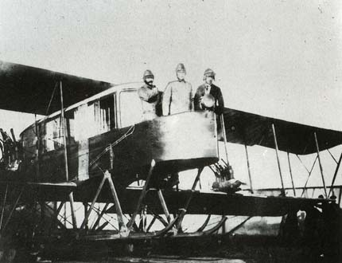
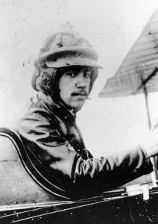
Igor Sikorsky
S-21 Grand
Four engine
Enclosed cabin
Observation platform
Notes:
Born in Kiev, Russia, on May 25, 1889, Igor (Ivan) Sikorsky developed an early interest in aviation. He learned of the Wright brothers during a trip to Germany as a youth and also became familiar with the work of Count Ferdinand von Zeppelin.
He graduated from the Petrograd Naval College and studied engineering in Paris and Kiev. In 1909, he returned to Paris, then the aeronautical center of Europe, to learn about the fledgling science. While there, he became acquainted with some of the men who would become well known in the field of aviation. Against their advice, Sikorsky decided to build a helicopter. He purchased a 25-horsepower (18.6-kilowatt) Anzani engine and returned to Kiev to begin building a rotary-wing aircraft. The helicopter failed, as did its successor due to a lack of power and understanding of the aerodynamics of vertical flight. Undeterred, Sikorsky turned his attention to fixed-wing aircraft.
His first fixed-wing plane, the S-1 failed, because its 15-horsepower (11.2-kilowatt) engine was inadequate. His second plane, the S-2 was a success. His fifth plane, the S-5, won him national recognition. With its 50-horsepower (37.3-kilowatt) engine, he could stay aloft for more than an hour, reach heights of 1,500 feet (457 meters), and make short trips. He also earned license number 64 from the Fédération Aéronautique Internationale. His S-6-A received the highest award at the 1912 Moscow Aviation Exhibition, and later that year, won first prize in the military competition at Petrograd. Sikorsky also began supplying aircraft to the Russian army.
His next step, which came about as a result of a mosquito-clogged carburetor and subsequent engine failure, was to design and build the world's first four-engine plane. "Le Grand," featured innovations such as an enclosed cabin, a lavatory, upholstered chairs, and an exterior catwalk atop the fuselage where passengers could get some fresh air. His next plane was the even larger Ilia Mourometz, which was used as a bomber during World War I.
The Russian Revolution ended Sikorsky's career in Russia. He immigrated to France where he was commissioned to build a bomber for Allied service. But the war ended and Sikorsky, after searching in vain for a position in French aviation, immigrated to the United States in 1919. After a few years in the United States, Sikorsky established his own company, the Sikorsky Aero Engineering Corporation. By 1929, the company was producing the S-38 twin-engine amphibians. In 1931, the first S-40, the 'American Clipper,' rolled off the assembly line. In the following years, his planes set new records for altitude, speed, and payload.
He made his most important contributions, however, in the area of helicopter design. His VS-300, first built and flown in 1939, became America's first successful helicopter and introduced a new mode of military and commercial transportation. On May 6, 1941, in an improved version, he established an international endurance record of 1 hour 32.4 seconds.
Sikorsky stayed active in his company until his death on October 26, 1972.
Russian-born helicopter pioneer Igor Sikorksky is long dead, but helicopters bearing his name still fly the skies. A subsidiary of United Technologies, Sikorsky Aircraft's military helicopters include the Black Hawk, used for troop assault, combat support, special operations, and medevac operations; and the Seahawk, used for submarine hunting, missile targeting, anti-surface ship warfare, and search and rescue. The company had been developing (with Boeing) the Comanche attack/scout helicopter, designed to utilize stealth technology (unlike Boeing's Apache), but the program was cancelled by the Army. Civil products include the S-76 and S-92, which are used for rescue, offshore oil, hospital, and corporate use.

Slide 24
Igor Sikorsky
Russian Civil War
Emigrates to United States (1919)
Sikorsky Manufacturing Company
S-29 One of first twin-engine aircraft in America
14 passenger capacity
115 MPH
Aviation Achievements
American Clipper – largest airliner produced
Wing flaps (1934)

Slide 25
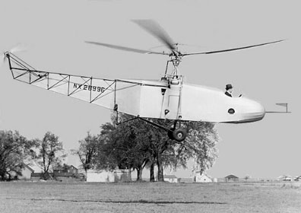
Igor Sikorsky
Helicopters
VS-300
First tethered flight (14 Sep 1935)
First free flight (24 May 1940)
R-4
First mass produced
helicopter (1942)
Configuration still used
today

Slide 26
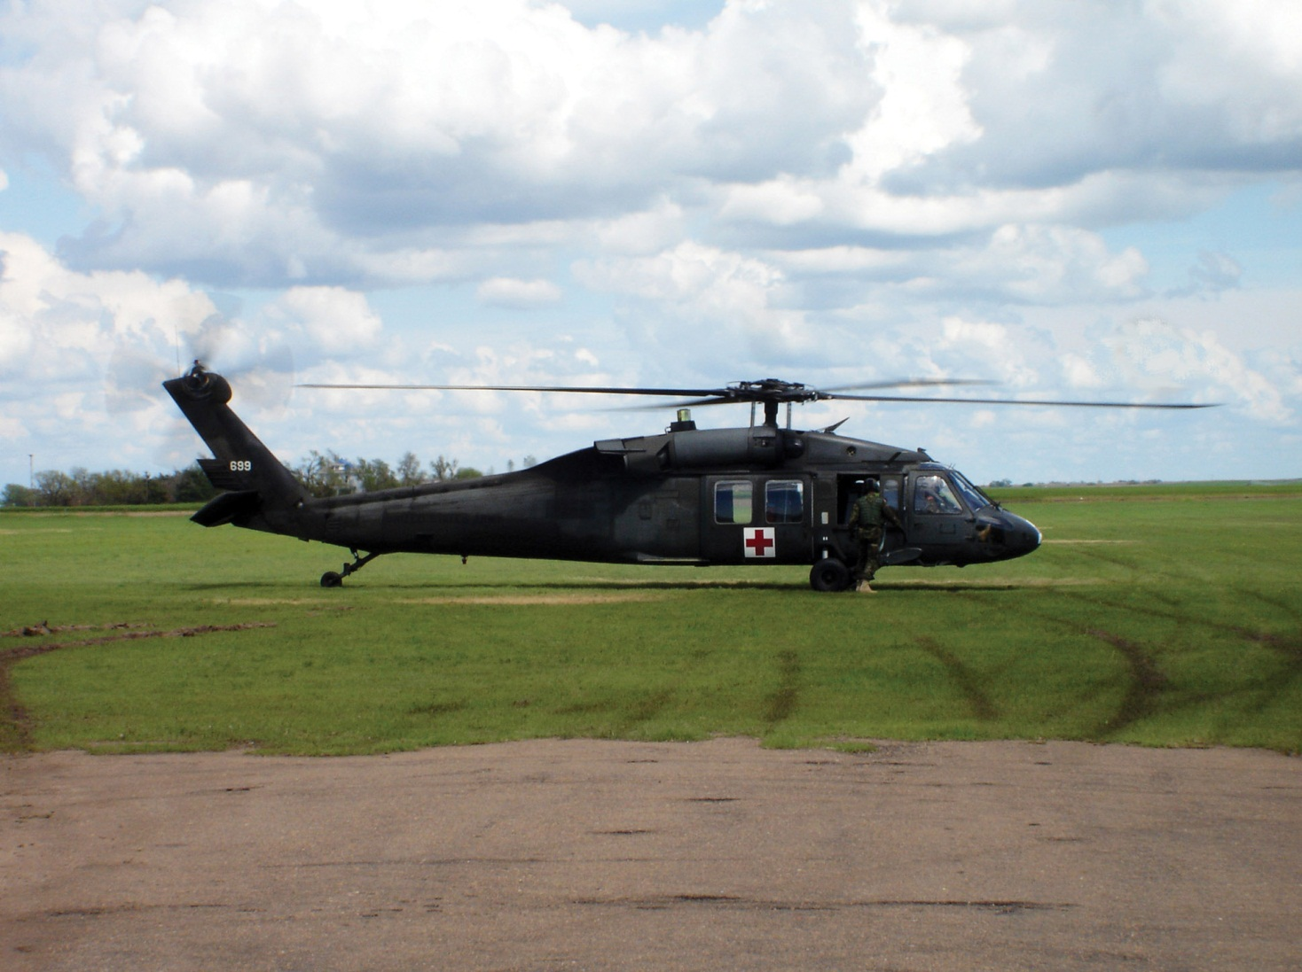
Igor Sikorsky
Blackhawk
Notes:
Born in Kiev, Russia, on May 25, 1889, Igor (Ivan) Sikorsky developed an early interest in aviation. He learned of the Wright brothers during a trip to Germany as a youth and also became familiar with the work of Count Ferdinand von Zeppelin.
He graduated from the Petrograd Naval College and studied engineering in Paris and Kiev. In 1909, he returned to Paris, then the aeronautical center of Europe, to learn about the fledgling science. While there, he became acquainted with some of the men who would become well known in the field of aviation. Against their advice, Sikorsky decided to build a helicopter. He purchased a 25-horsepower (18.6-kilowatt) Anzani engine and returned to Kiev to begin building a rotary-wing aircraft. The helicopter failed, as did its successor due to a lack of power and understanding of the aerodynamics of vertical flight. Undeterred, Sikorsky turned his attention to fixed-wing aircraft.
His first fixed-wing plane, the S-1 failed, because its 15-horsepower (11.2-kilowatt) engine was inadequate. His second plane, the S-2 was a success. His fifth plane, the S-5, won him national recognition. With its 50-horsepower (37.3-kilowatt) engine, he could stay aloft for more than an hour, reach heights of 1,500 feet (457 meters), and make short trips. He also earned license number 64 from the Fédération Aéronautique Internationale. His S-6-A received the highest award at the 1912 Moscow Aviation Exhibition, and later that year, won first prize in the military competition at Petrograd. Sikorsky also began supplying aircraft to the Russian army.
His next step, which came about as a result of a mosquito-clogged carburetor and subsequent engine failure, was to design and build the world's first four-engine plane. "Le Grand," featured innovations such as an enclosed cabin, a lavatory, upholstered chairs, and an exterior catwalk atop the fuselage where passengers could get some fresh air. His next plane was the even larger Ilia Mourometz, which was used as a bomber during World War I.
The Russian Revolution ended Sikorsky's career in Russia. He immigrated to France where he was commissioned to build a bomber for Allied service. But the war ended and Sikorsky, after searching in vain for a position in French aviation, immigrated to the United States in 1919. After a few years in the United States, Sikorsky established his own company, the Sikorsky Aero Engineering Corporation. By 1929, the company was producing the S-38 twin-engine amphibians. In 1931, the first S-40, the 'American Clipper,' rolled off the assembly line. In the following years, his planes set new records for altitude, speed, and payload.
He made his most important contributions, however, in the area of helicopter design. His VS-300, first built and flown in 1939, became America's first successful helicopter and introduced a new mode of military and commercial transportation. On May 6, 1941, in an improved version, he established an international endurance record of 1 hour 32.4 seconds.
Sikorsky stayed active in his company until his death on October 26, 1972.
Russian-born helicopter pioneer Igor Sikorksky is long dead, but helicopters bearing his name still fly the skies. A subsidiary of United Technologies, Sikorsky Aircraft's military helicopters include the Black Hawk, used for troop assault, combat support, special operations, and medevac operations; and the Seahawk, used for submarine hunting, missile targeting, anti-surface ship warfare, and search and rescue. The company had been developing (with Boeing) the Comanche attack/scout helicopter, designed to utilize stealth technology (unlike Boeing's Apache), but the program was cancelled by the Army. Civil products include the S-76 and S-92, which are used for rescue, offshore oil, hospital, and corporate use.

Slide 27
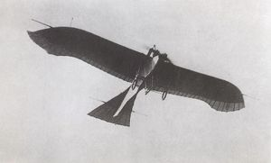
German Airplanes
Lagged behind world
Obtained licenses for foreign design production
German airplane works
E. Rumpler founded with an Etrich license
Bird-like design called Taube (Dove)
License waived
Basic German design
Notes:
The Rumpler Taube is a pre-World War I monoplane aircraft, and the first mass produced military plane in Germany. Being the Germans' first practical military plane, it was used for all common military aircraft applications, including as a fighter, bomber, surveillance plane and trainer from its first flight in 1910 until the beginning of World War I. Due to the rapid advancement of aviation during the war, the design was obsolete by 1914. Despite its name, the Taube (German: dove) was not modeled after a bird, but after the Zanonia macrocarpa seeds, which glide to the ground in a slow spin induced by a single wing. Similar wing shapes have also been used by Karl Jatho. While Etrich had tried to build a flying wing aircraft based on the Zanonia wing shape, the conventional Taube was much more successful.
Most notably, the plane did not have ailerons in the wings. Instead, the pilot turned the plane by warping the wings (effectively providing the same functionality as ailerons) and using the elevators at the rear of the tail.

Slide 28
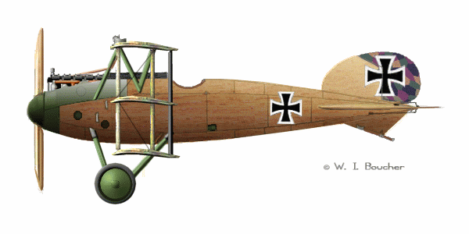
German Airplanes
Before war, 25 aircraft production companies
French influence
Albatross design
Farman boxkite type
Government backing
H. Oelerich
Altitude Record
26,740 feet
Notes:
The Rumpler Taube is a pre-World War I monoplane aircraft, and the first mass produced military plane in Germany. Being the Germans' first practical military plane, it was used for all common military aircraft applications, including as a fighter, bomber, surveillance plane and trainer from its first flight in 1910 until the beginning of World War I. Due to the rapid advancement of aviation during the war, the design was obsolete by 1914. Despite its name, the Taube (German: dove) was not modeled after a bird, but after the Zanonia macrocarpa seeds, which glide to the ground in a slow spin induced by a single wing. Similar wing shapes have also been used by Karl Jatho. While Etrich had tried to build a flying wing aircraft based on the Zanonia wing shape, the conventional Taube was much more successful.
Most notably, the plane did not have ailerons in the wings. Instead, the pilot turned the plane by warping the wings (effectively providing the same functionality as ailerons) and using the elevators at the rear of the tail.

Slide 29
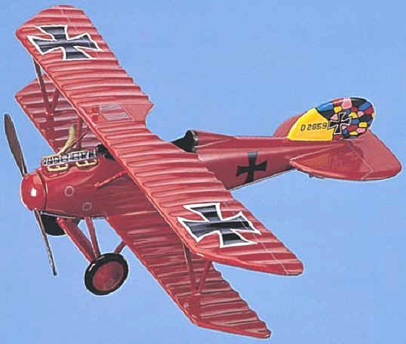
German Albatross
Notes:
The Rumpler Taube is a pre-World War I monoplane aircraft, and the first mass produced military plane in Germany. Being the Germans' first practical military plane, it was used for all common military aircraft applications, including as a fighter, bomber, surveillance plane and trainer from its first flight in 1910 until the beginning of World War I. Due to the rapid advancement of aviation during the war, the design was obsolete by 1914. Despite its name, the Taube (German: dove) was not modeled after a bird, but after the Zanonia macrocarpa seeds, which glide to the ground in a slow spin induced by a single wing. Similar wing shapes have also been used by Karl Jatho. While Etrich had tried to build a flying wing aircraft based on the Zanonia wing shape, the conventional Taube was much more successful.
Most notably, the plane did not have ailerons in the wings. Instead, the pilot turned the plane by warping the wings (effectively providing the same functionality as ailerons) and using the elevators at the rear of the tail.

Slide 30
Aerial Experiment Association
Alexander Graham Bell organized in1907
J.A.D. McCurdy
Lt. Thomas Selfridge
Thomas Baldwin
Glenn Curtiss
Purpose – build a practical aircraft
Notes:
The Aerial Experiment Association (AEA) was formed in 1907 under the tutelage of Dr. Alexander Graham Bell.
The AEA came into being when John Alexander Douglas McCurdy and his friend Frederick W. "Casey" Baldwin, two young engineers fresh out of the University of Toronto, decided to spend the summer in Baddeck, Nova Scotia. McCurdy had grown up there, and his father was the personal secretary of Dr. Bell. He had grown up close to the Bell family and was well received in their home. One day, as the three sat with Dr. Bell discussing the problems of aviation, Bell's wife, Mabel, suggested they form a company to exploit their collective ideas. Being independently wealthy, she offered to bankroll the idea, taking care of one of the major problems facing aviators of the day.
The American motorcycle designer and manufacturer, and recognized expert on gasoline engines, Glenn H. Curtiss also became a member of the association. Curtiss had visited the Wright Cycle Company to discuss aeronautical engineering with Wilbur and Orville Wright but the Wrights did not want to cooperate with him in the development of aircraft. The group attracted sufficient attention to inspire the United States government to request that an official observer be allowed to join. Their nominee was US Army Lieutenant Thomas Selfridge who was later to be the first person killed in an airplane accident.
This collaboration lead to very public success. Casey Baldwin became the first Canadian pilot during a March 1908 flight of Red Wing. Its successor, White Wing was the first plane to have Bell's ailerons. One of their planes, the June Bug, won the Scientific American Trophy by making the first official one kilometer flight in North America; although, the Wrights had already accomplished this in 1904. Their fourth flying machine, the Silver Dart, constructed in 1908, made the first controlled powered flight in Canada on February 23, 1909 when it was flown off the ice of Bras d'Or Lake near Baddeck by McCurdy who had been one of its designers. On March 10, 1909, McCurdy set a record when he flew the airplane on a circular course over a distance of more than 32 km (20 miles), a feat that the Wrights had already accomplished in 1905. The Association made the first passenger flight in Canada on August 2, also in the Silver Dart. Much development also took place in Hammondsport, New York where experimentation was done on development of the first seaplane.
The association disbanded on March 31, 1909.

Slide 31
Aerial Experiment Association
Built 4 airplanes in 1908
#1 Red Wing
Biplane
Forward elevator
Fixed rear stabilizer and movable rear rudder
No wing warping or ailerons
Ice skids
Thomas Baldwin flew twice
Crash landed both times
Notes:
The Aerial Experiment Association (AEA) was formed in 1907 under the tutelage of Dr. Alexander Graham Bell.
The AEA came into being when John Alexander Douglas McCurdy and his friend Frederick W. "Casey" Baldwin, two young engineers fresh out of the University of Toronto, decided to spend the summer in Baddeck, Nova Scotia. McCurdy had grown up there, and his father was the personal secretary of Dr. Bell. He had grown up close to the Bell family and was well received in their home. One day, as the three sat with Dr. Bell discussing the problems of aviation, Bell's wife, Mabel, suggested they form a company to exploit their collective ideas. Being independently wealthy, she offered to bankroll the idea, taking care of one of the major problems facing aviators of the day.
The American motorcycle designer and manufacturer, and recognized expert on gasoline engines, Glenn H. Curtiss also became a member of the association. Curtiss had visited the Wright Cycle Company to discuss aeronautical engineering with Wilbur and Orville Wright but the Wrights did not want to cooperate with him in the development of aircraft. The group attracted sufficient attention to inspire the United States government to request that an official observer be allowed to join. Their nominee was US Army Lieutenant Thomas Selfridge who was later to be the first person killed in an airplane accident.
This collaboration lead to very public success. Casey Baldwin became the first Canadian pilot during a March 1908 flight of Red Wing. Its successor, White Wing was the first plane to have Bell's ailerons. One of their planes, the June Bug, won the Scientific American Trophy by making the first official one kilometer flight in North America; although, the Wrights had already accomplished this in 1904. Their fourth flying machine, the Silver Dart, constructed in 1908, made the first controlled powered flight in Canada on February 23, 1909 when it was flown off the ice of Bras d'Or Lake near Baddeck by McCurdy who had been one of its designers. On March 10, 1909, McCurdy set a record when he flew the airplane on a circular course over a distance of more than 32 km (20 miles), a feat that the Wrights had already accomplished in 1905. The Association made the first passenger flight in Canada on August 2, also in the Silver Dart. Much development also took place in Hammondsport, New York where experimentation was done on development of the first seaplane.
The association disbanded on March 31, 1909.

Slide 32
Aerial Experiment Association
#2 White Wing
Biplane
Tricycle landing gear
Ailerons
Movable control surfaces on four wingtips
Baldwin, Curtiss, McCurdy successful flights
McCurdy crashed
Notes:
The Aerial Experiment Association (AEA) was formed in 1907 under the tutelage of Dr. Alexander Graham Bell.
The AEA came into being when John Alexander Douglas McCurdy and his friend Frederick W. "Casey" Baldwin, two young engineers fresh out of the University of Toronto, decided to spend the summer in Baddeck, Nova Scotia. McCurdy had grown up there, and his father was the personal secretary of Dr. Bell. He had grown up close to the Bell family and was well received in their home. One day, as the three sat with Dr. Bell discussing the problems of aviation, Bell's wife, Mabel, suggested they form a company to exploit their collective ideas. Being independently wealthy, she offered to bankroll the idea, taking care of one of the major problems facing aviators of the day.
The American motorcycle designer and manufacturer, and recognized expert on gasoline engines, Glenn H. Curtiss also became a member of the association. Curtiss had visited the Wright Cycle Company to discuss aeronautical engineering with Wilbur and Orville Wright but the Wrights did not want to cooperate with him in the development of aircraft. The group attracted sufficient attention to inspire the United States government to request that an official observer be allowed to join. Their nominee was US Army Lieutenant Thomas Selfridge who was later to be the first person killed in an airplane accident.
This collaboration lead to very public success. Casey Baldwin became the first Canadian pilot during a March 1908 flight of Red Wing. Its successor, White Wing was the first plane to have Bell's ailerons. One of their planes, the June Bug, won the Scientific American Trophy by making the first official one kilometer flight in North America; although, the Wrights had already accomplished this in 1904. Their fourth flying machine, the Silver Dart, constructed in 1908, made the first controlled powered flight in Canada on February 23, 1909 when it was flown off the ice of Bras d'Or Lake near Baddeck by McCurdy who had been one of its designers. On March 10, 1909, McCurdy set a record when he flew the airplane on a circular course over a distance of more than 32 km (20 miles), a feat that the Wrights had already accomplished in 1905. The Association made the first passenger flight in Canada on August 2, also in the Silver Dart. Much development also took place in Hammondsport, New York where experimentation was done on development of the first seaplane.
The association disbanded on March 31, 1909.

Slide 33
Aerial Experiment Association
#3 June Bug/Loon
Improved on #1 and #2
Numerous flights
Scientific American Trophy
Won by Curtiss
Fly one kilometer in a straight line
Loon
Equipped with pontoons
Sank during taxi
Notes:
The Aerial Experiment Association (AEA) was formed in 1907 under the tutelage of Dr. Alexander Graham Bell.
The AEA came into being when John Alexander Douglas McCurdy and his friend Frederick W. "Casey" Baldwin, two young engineers fresh out of the University of Toronto, decided to spend the summer in Baddeck, Nova Scotia. McCurdy had grown up there, and his father was the personal secretary of Dr. Bell. He had grown up close to the Bell family and was well received in their home. One day, as the three sat with Dr. Bell discussing the problems of aviation, Bell's wife, Mabel, suggested they form a company to exploit their collective ideas. Being independently wealthy, she offered to bankroll the idea, taking care of one of the major problems facing aviators of the day.
The American motorcycle designer and manufacturer, and recognized expert on gasoline engines, Glenn H. Curtiss also became a member of the association. Curtiss had visited the Wright Cycle Company to discuss aeronautical engineering with Wilbur and Orville Wright but the Wrights did not want to cooperate with him in the development of aircraft. The group attracted sufficient attention to inspire the United States government to request that an official observer be allowed to join. Their nominee was US Army Lieutenant Thomas Selfridge who was later to be the first person killed in an airplane accident.
This collaboration lead to very public success. Casey Baldwin became the first Canadian pilot during a March 1908 flight of Red Wing. Its successor, White Wing was the first plane to have Bell's ailerons. One of their planes, the June Bug, won the Scientific American Trophy by making the first official one kilometer flight in North America; although, the Wrights had already accomplished this in 1904. Their fourth flying machine, the Silver Dart, constructed in 1908, made the first controlled powered flight in Canada on February 23, 1909 when it was flown off the ice of Bras d'Or Lake near Baddeck by McCurdy who had been one of its designers. On March 10, 1909, McCurdy set a record when he flew the airplane on a circular course over a distance of more than 32 km (20 miles), a feat that the Wrights had already accomplished in 1905. The Association made the first passenger flight in Canada on August 2, also in the Silver Dart. Much development also took place in Hammondsport, New York where experimentation was done on development of the first seaplane.
The association disbanded on March 31, 1909.

Slide 34
Aerial Experiment Association
#4 Silver Dart
50 HP water-cooled engine
First flight in Canada
McCurdy flew
AEA disbanded in 1909
Completed agenda
Applied for many patents
Legacy – Herring-Curtiss aircraft manufacturing company
Notes:
The Aerial Experiment Association (AEA) was formed in 1907 under the tutelage of Dr. Alexander Graham Bell.
The AEA came into being when John Alexander Douglas McCurdy and his friend Frederick W. "Casey" Baldwin, two young engineers fresh out of the University of Toronto, decided to spend the summer in Baddeck, Nova Scotia. McCurdy had grown up there, and his father was the personal secretary of Dr. Bell. He had grown up close to the Bell family and was well received in their home. One day, as the three sat with Dr. Bell discussing the problems of aviation, Bell's wife, Mabel, suggested they form a company to exploit their collective ideas. Being independently wealthy, she offered to bankroll the idea, taking care of one of the major problems facing aviators of the day.
The American motorcycle designer and manufacturer, and recognized expert on gasoline engines, Glenn H. Curtiss also became a member of the association. Curtiss had visited the Wright Cycle Company to discuss aeronautical engineering with Wilbur and Orville Wright but the Wrights did not want to cooperate with him in the development of aircraft. The group attracted sufficient attention to inspire the United States government to request that an official observer be allowed to join. Their nominee was US Army Lieutenant Thomas Selfridge who was later to be the first person killed in an airplane accident.
This collaboration lead to very public success. Casey Baldwin became the first Canadian pilot during a March 1908 flight of Red Wing. Its successor, White Wing was the first plane to have Bell's ailerons. One of their planes, the June Bug, won the Scientific American Trophy by making the first official one kilometer flight in North America; although, the Wrights had already accomplished this in 1904. Their fourth flying machine, the Silver Dart, constructed in 1908, made the first controlled powered flight in Canada on February 23, 1909 when it was flown off the ice of Bras d'Or Lake near Baddeck by McCurdy who had been one of its designers. On March 10, 1909, McCurdy set a record when he flew the airplane on a circular course over a distance of more than 32 km (20 miles), a feat that the Wrights had already accomplished in 1905. The Association made the first passenger flight in Canada on August 2, also in the Silver Dart. Much development also took place in Hammondsport, New York where experimentation was done on development of the first seaplane.
The association disbanded on March 31, 1909.

Slide 35
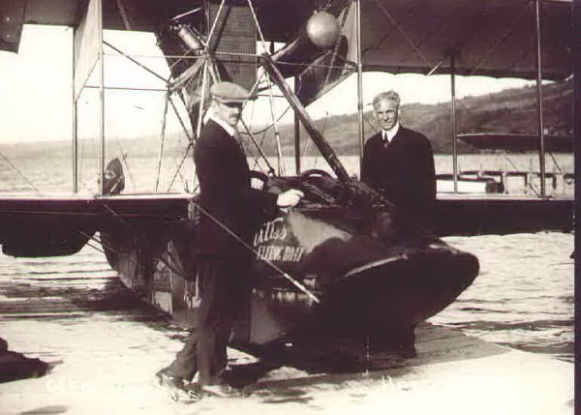
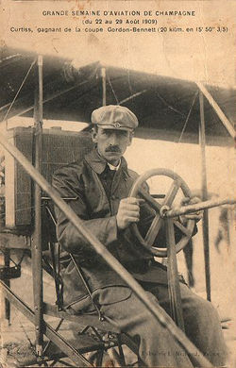
Glen Curtiss
Glenn H. Curtiss at the Grande Semaine d'Aviation in France in 1909
Notes:
Henry Ford, 50, visiting Glenn Curtiss, 35, Hammondsport, N.Y., 1913. "Mr. Henry Ford of Detroit - the manufacturer of the Ford car - paid us a visit. He wanted to go up but said, 'My wife won't let me.'"
Three of mankind's greatest inventions occurred in the years beginning this story: The telephone, the automobile, and the airplane - with all engulfed in momentous patent battles. The victors of two, Alexander Graham Bell and Henry Ford, then played crucial roles in the third, the epic fight between the Wright brothers and Glenn Curtiss.
In 1953, Briton Charles G. Grey (1875-1953), arguably the world's most knowledgeable person on flight's early days (founder and editor, The Aeroplane, 1911-1939; editor, Jane's All The World's Aircraft, 1916-1941), wrote (see "Letters, Documents, Exhibits"):
"Strange thing isn't it that the U.S.A. has never recognized Glenn Curtiss as by far the greatest man America (both North & South) has ever produced in Aviation? - Think of the early Hammondsport products. Then the Jenny...Then the first flight onto & off a ship. Then the first flying boats. Then the big & little Americas (of 1916-18) & their descendants, the F boats of Felixstowe, from which descend all…trans-Atlantic boats...Then the N.C. boats, first across the Atlantic, & the string of Curtiss record-breakers, & Schneider winners. And the D-12 engine, from which the Rolls Falcon, & ultimately the Merlin are descended...So far as I know there is nobody in the World who has claim to have influenced aircraft design & production as he did, or had done. But the capitalists who bought the bogus Wright patents ganged up on Curtiss & `slapped him down,' as they say in the States, & he was too proud to fight back on propaganda. He left his products to fight for him."

Slide 36
Glen Curtiss
Manufactured motorcycles and bicycles
Built motor for Baldwin dirigibles
Joined AEA
Scientific knowledge/practical experience
First aircraft manufacturing company
Pusher bi-planes
Used ailerons – patent dispute with Wright Bros.
Designed aircraft for US Navy
Take off from and land on ships
Flying boats in 1912
Second only to Wright Bros. in influence

Slide 37
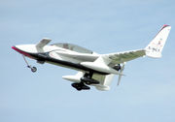
Pusher Airplanes
The pusher configuration on a Rutan Long-EZ home-built aircraft
A British WWI-era F.E.2b pusher. The propeller is just behind the wing
Notes:
A British WWI-era F.E.2b pusher. The propeller is just behind the wing.

Slide 38
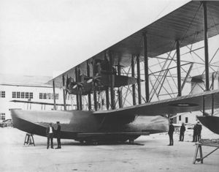
Curtiss Airplanes
"NC-1" after completion, in 3 engine configuration, 3 October, 1918.
Notes:
The patent dispute with the Wright brothers continued for several years until it was resolved during World War I, just after Wright ceased making airplanes following Orville's withdrawal from the business and the company's shift to manufacturing only engines. The last Wright airplane was a single copy, made in 1916. With the involvement of the U.S. in World War I in 1917, the U.S. government gave a large and profitable contract to Curtiss to build airplanes for the U.S. Army. After Wilber Wright died, his brother Orville sold the Wright Aeronautical Company to Curtiss Aeroplane and Motor Company on 5 July 1929, forming the Curtiss-Wright company, finally ending all possible further disputes just before Glenn Curtiss's death The NC-4 was one of four NC (Navy-Curtiss) flying-boats, built during World War I originally to provide patrol cover for American shipping in the Atlantic against the attentions of German U-boats. The requirement was drawn up, and the aircraft designed, by the Navy in September 1917. It featured a short 45 ft. (13.72 m) length hull of advanced hydrodynamic design, and was intended to be powered by three engines. The first four aircraft were numbered separately NC-1 to NC-4, but the war was ending even as flight testing began. The NC-1 (three 400 hp Liberty engines) flew for the first time on October 4,1918, and on November 25 gave striking proof of its load-lifting abilities by carrying 51 people on a single flight -- a world record. Nevertheless, the three-engined installation was considered inadequate for transatlantic flying, and completion of the second, third and fourth aircraft was delayed while a fourth engine was included in the design. First flights were made on April 12 (NC-2), April 23 (NC-3) and April 30 (NC-4), NC-2 having been modified with its engine mounted as tandem pairs was found to be an unsatisfactory configuration, while the other two aircraft retained the between-wings separate tractor layout of three engines and had the fourth mounted, as a pusher, at the rear of the hull. It was decided to enter the Navy-Curtiss machines for the transatlantic attempt, for which they were redesignated NC-TA. On March 27 the NC-1's right wing had sustained storm damage, and was given the wing from NC-2. The NC-2 whose engine layout had proved unsatisfactory was again cannibalized to supply parts for the NC-1 when its left wing was damaged by fire on May 5 in a hangar at Rockaway, New York. The Journey Begins On Thursday morning, 8 May, NC-1 NC-3, and NC-4 took off from Rockaway for Halifax, Nova Scotia, on the first leg of the transatlantic journey. The flight was under the command of John Towers, who was also commanding officer and navigator of NC-3. NC-4 was commanded by Lieutenant Commander Albert C. Read, and NC-1 by Lieutenant Commander Patrick N. L. Bellinger.
Offshore of Cape Cod, NC-4's center engines failed; she landed at sea and taxied to the Naval Air Station at Chatham, Massachusetts, for repairs. NC-3 and NC-1 arrived at Halifax without incident, but next morning serious cracks were discovered in their propellers and a day was lost replacing them.

Slide 39
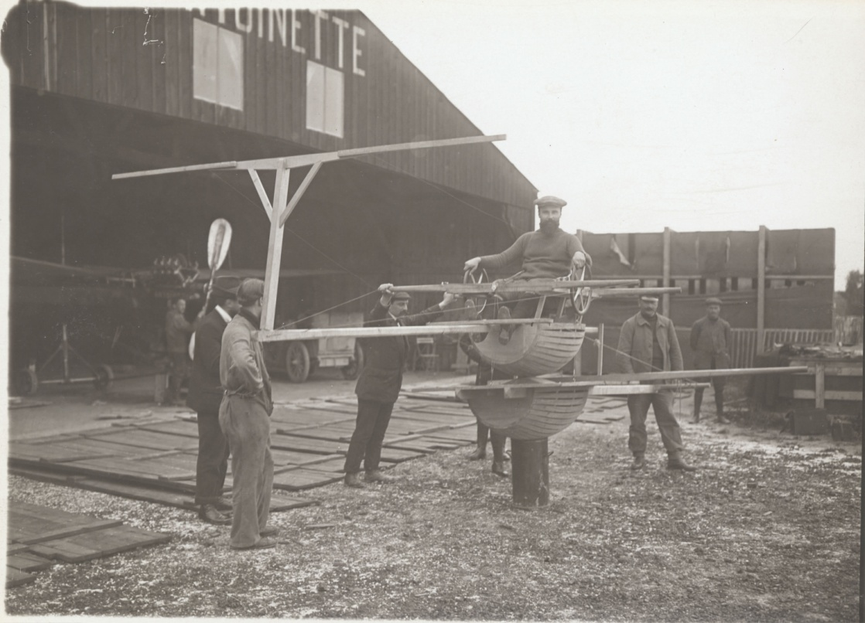
Curtiss Flight School
Notes:
Flight schoolsFlight Training School Simulator
Front left view of a student using a Tonneau d'apprentissage at the École de Pilotage "Antoinette" [Antoinette Piloting School] at Mourmelon-le-Grande, France. This is the earliest known (to National Air and Space Museum Archives) aircraft flight training simulator to be photographed.
Mourmelon-le-Grande, France, circa 1911
College Park Airport ‘Firsts' 1909--First military officer to solo (Lt. Frederick Humphreys). 1909--The first woman to fly as a passenger in America (Mrs. Ralph H. VanDeman with Wilbur Wright on October 27). 1909--The first U.S. naval officer to fly (Lt. George Sweet flew with Lt. Lahm on November 3). 1911--First testing of a bomb sight from an airplane. 1911--First military aviation school. 1911--Start of the first cross-country flight. 1911--Start of the first military cross-country flight (Hap Arnold flew a Burgess-Wright aircraft from College Park to Frederick, Md., 42 miles). 1911--First member of Congress to be flown by the U.S. Army (Rep. Ben Johnson [Kentucky], chairman of the House District Committee, a passenger with Hap Arnold). 1911--Very early aerial photograph taken from a fixed-wing aircraft at College Park. (The Army flight school was photographed from an altitude of 600 feet. Other photos of the area were taken at 1,500 and 2,000 feet, all with a small-lens Kodak camera.) 1912--Introduction of the "Military Aviator" rating for pilots. 1912--First testing of a machine gun from an airplane. 1912--First mile-high flight by a military aviator (Hap Arnold). 1912--The first competition for the MacKay Trophy (won by Hap Arnold). 1912--First military enlisted man to die in an airplane accident (Cpl. Frank S. Scott, U.S. Army). 1918--First U.S. Postal Air Mail Service. 1924--First controlled helicopter flight (H. Berliner). 1927--1934 First development and testing of radio navigation aids, the predecessor of the instrument landing system. 1931--First blind instrument landing made solely by reference to navigational instruments (Jimmy Doolittle made the first blind landing at Mitchel Field, Long Island, N.Y., on Sept. 24, 1929). 1933--First completely blind flight from College Park to Newark (N.J.) Municipal Airport (during which radio was the sole means of directional guidance and landing).

Slide 40
Naval Flight Training
Ely takes off from the USS Birmingham, Hampton Roads, Virginia, November 14, 1910
Notes:
In late 1910, Glenn Curtiss established a flight training school at North Island, San Diego, California and he offered the Navy a proposition it couldn't refuse. Curtiss would "instruct an officer of the Navy in the operation and construction of the Curtiss airplane” as a means of assisting "in developing the adaptability of the airplane to military purposes." As a result, Ellyson was ordered on December 23rd, 1910, to report to the Glenn Curtiss Aviation Camp at North Island to undergo flight training. In January 1911 he became the first naval officer assigned to aviation.
However, Theodore "Spuds" Ellyson
before his flight training started Ellyson assisted Curtiss in further demonstrating the military value of the airplane in warfare. In particular, Ellyson made suggestions regarding the use and placement of the sandbag arresting gear which was crucial to Ely’s successful landing and take-off from the USS Pennsylvania on January 18th, 1911.
In February 1911, Ellyson began serious flight training using the four cylinder machine for ground runs and then progressing through short jumps, longer jumps and straight away flights of up to a mile and a half. In March he began using the eight cylinder machine and making turns. Finally on March 31st he reported, "in my opinion and that of Mr. Curtiss, I have qualified in practical aviation under favorable weather conditions. I have had no practice in flying the hydro-airplane."
In March 1911, the Navy's Bureau of Navigation received an appropriation of $25,000 for experiments in aeronautics and on May 8th, 1911, two requisitions were prepared for Curtiss biplanes. The first for a Triad, an amphibian plane equipped for landing and taking off on land or water. The plane was also equipped with a metal tipped propeller designed to achieve speeds of at least 45 miles per hour, provisions for carrying a passenger, and dual controls operated by either pilot or passenger. This airplane later became the Navy's first airplane which they dubbed the "A-1."
The first flight of the A-1 began on July 1st, 1911 from Hammondsport, NY with Glenn Curtiss's later landing in Lake Keuka, NY. The flight only lasted five minutes but reached an altitude of 25 feet. That same evening, Ellyson made two solo flights for which he was granted pilot certificate No. 28 and expert aviator certificate No. 26 and years later, Ellyson was designated Naval Aviator No. 1. On July, 3rd, 1911, Ellyson achieved another first, landing on water in the dark.
Determined to display the capability of launching planes from Navy ships, Curtiss and Ellyson worked on a launching system which they tested September 7th, 1911. Lt. Ellyson successfully took off from an inclined three-wire cable runway rigged from a 16 foot high platform on the beach, 250 feet into the water of Lake Keuka. The crude system used the power of two men who pulled ropes attached to the wings, launching the plane in the air and thus, proving the possibility of launching airplanes from ships and landing them on water.
More than just improving planes and working on launching systems, Ellyson also was the first to advocate for special flight clothing in a letter dated September 16th, 1911. Outlining the requirements Ellyson list included: a light helmet with detachable goggles or visor, with covering for the ears and yet holes so that the engine could be heard; a leather coat lined with fur or wool; leather trousers; high rubber galoshes and gauntlets; and a life preserver. He also prepared the first check-off lists for inspecting an aircraft after its assembly and prior to each flight.
On July 31st, 1912, Ellyson became the first person to be launched from the experimental catapult system. They Navy spent time and money perfecting an air-compressed catapult system and mounted it on the Santee Dock in Annapolis. The first attempt almost killed Ellyson when the plane left the ramp with its nose pointing upward and caught a crosswind pushing the plane straight into the water. Ellyson was able to escape from the wreckage unhurt and still pining to make the first successful catapult launching.
The second attempt was scheduled for November 12th, 1912. This time, Ellyson had found his lucky charm: Helen. Ellyson and Helen had met at a wedding reception two weeks before the second attempt and he knew instantly that she was a good luck charm. Not only did the marriage work, but the catapult launch did as well.
As with many test pilots, when Ellyson received the call to return to combat, he answered it and returned to the sea. Spending some time in Europe and stateside during World War I, Ellyson held many different duties and was promoted to commander in July 1918. Not be until January 10th, 1921 would Ellyson return to aviation duty, where he was assigned to the newly formed Bureau of Aeronautics with the Department of the Navy. On June 23rd, 1926, Ellyson was assigned to outfit the USS Lexington, the Navy’s second aircraft carrier.
Tragedy struck on February 27th, 1928, Ellyson 43rd birthday, when he received a dispatch from Annapolis with word that one of his daughters was ill. Granted a leave, he immediately left the carrier aboard an amphibian plane to make a two hour flight to Annapolis. He never made it to Annapolis. For over a month the Navy searched for the missing plane, but to no avail. Ellyson’s body washed ashore on April 11th, 1928.
In a career which spanned thirty years, Ellyson was the first to accomplish many things. He was the first to be assigned as a Naval aviator, the first to fly a Naval plane, the first to land at night on water, the first to be catapulted unsuccessfully and successfully in an airplane, and he was designated Naval Aviator No. 1.

Slide 41
Exhibition/Stunt Flying
Crowds came to airplane flights
Speed races
Exhibitions
Crashes
First exhibition flyers?
Wright Bros.
Glenn Curtiss
Alberto Santos Dumont
Louis Bleriot

Slide 42
Exhibition/Stunt Flying
Hudson-Fulton Tercentenary Celebration
New York – 1909
Winds grounded flights
Curtiss left for engagement
Wrights flew two days later
Publicity bonanza
Disaster for Curtiss
Curtiss forms exhibition team
Wrights react

Slide 43
Exhibition/Stunt Flying
Cromwell Dixon
Curtiss exhibition flyer
First to fly across continental divide
$10,000 prize
Died days later in crash
Lincoln Beachey
Known for crashes as his flights
Died in 1915
Wings fell off

Slide 44
Aero Clubs
National Aero Clubs
Aviation competitions
Certified flight records
Presented awards
Issued pilot licenses
Provide witnesses
Documentation and verification of records

Slide 45
Aero Clubs
Aero Club of America
First to officially support Wright Bros. claims
Issued first licenses – promote safety
Unlicensed pilots
Excluded from club-sanctioned competitions
Insurance companies – required license
Granted licenses in 1910
Glenn Curtiss
Lt. Frank Lahm
Louis Paulhan
Orville & Wilbur Wright

Slide 46
Aero Club of America
Applicants
21 years of age
Make 3 solo flights
Under supervision of club
Demonstrate safe flight skills
Club Agent granted license
Watched applicant’s flight test
From ground
First American woman – Harriet Quimby 1911
Licenses from 1910 to 1927
Federal government began

Slide 47
Air Shows
Rheims France - 1909
23 aircraft entered
Many air shows followed

Slide 48
Newspapers Sponsor Competitions
Daily Mail of London
Harry Harper – first full time aviation reporter
Sponsored competitions
1907 – fly off for model aircraft
Alliot Verdon Roe
Built full-size airplane from winnings
1909 – First Briton to fly one continuous mile
J.T.C. Moore-Brabazon – 1,000 pounds
1909 – English Channel Crossing
1910 – London-to-Manchester race
Louis Paulhan – 10,000 pounds

Slide 49
American Newspaper Competitions
New York World
New York to Albany
Glenn Curtiss - May 1910
Philadelphia Public Ledger
Round trip New York to Philadelphia
Charles Hamilton - $10,000
William Randolph Hearst
$50,000 prize – first transcontinental flight
Within 30 days
Offer expired in 1 year
Cal Rodgers - took 49 days

Slide 50
Gordon Bennett Races
International Cup balloon races
Switched to airplane races - 1908
First at Rheims 1909
Glenn Curtiss won
Moved to United States in 1910
Atlantic Crossing
Daily Mail offered 10,000 pounds
Many considered it suicide
War

Slide 51
Patents
Wright Bros. vs. Herring-Curtiss
Curtiss Gold Bug was center of patent fight
Aileron placement was key
Curtiss defense
Deny infringement
Herring patent defense
Herring-Curtiss bankruptcy
Injunction lifted
Curtiss Aeroplane Company
European Battles

Slide 52
Technology
Wrights lagged in technology
Automatic Stability
Orville Wright vs. Elmer Sperry
Automatic stability system – 1911
Gyroscopic stabilizer – 1914
Ailerons vs wing warping
Wheels
Control
Curtiss – Control wheel
Wrights - Levers

Slide 53
Technology
Engine Production
France led way
165 pounds/50 HP
United States
34 manufacturers before war
25 to 200 HP
Flight Schools
Manufacturers taught school

Slide 54
Airports
United States
College Park Maryland
Lights for night flights
Airfield usage
Military
Training and maneuvers
Manufacturers
Test flights and demonstration flights
Proximity to both land and water

Slide 55
Aviation Developments
French Aero Clubs
Aerial Roads
Line of visual aids to guide along route
Airmail
Throughout world
Commercial
Limited prior to war

Slide 56
Aviation Developments
Aerial Laws
First appeared in 1911
Aerial traffic free
Subject to nation controlling airspace
Aircraft
Register in one country/residency of owner
Display mark of nationality
Land in open fields
Not within cities or military fortifications
No jettisoning or dropping of objects

Slide 57
Early Flight
Octave Chanute – gliders
Airplane Production
German Airplanes
Curtiss Airplanes/Flight School
Naval Flight Training
Competitions

