Slide 1
NOTAMs

Slide 2
NOtices To AirMen
Provide the most current information available.
Time-critical information on airports and changes that affect national airspace as pertain to IFR operations.
Notes:
Overview of airspace:
The following are general descriptions and dimensions.
The markings are standardized but the size and shape of the airspace is varied according to the need for that particular area.
Airspace dimensions are as depicted on the current sectional, world and/or terminal charts.

Slide 3
Notices to AirMen
Four Categories:
NOTAM D: attached to hourly weather reports and available at FSS.
NOTAM FDC: issued by Flight Data Center and contain regulatory information such as temp flight restrictions or amendment to instrument app procedures
Both contained in the Notices to Airman publication, issued every 28 days
Notes:
Special Use Airspace:
Prohibited Areas are denoted as a blue comb line.
Restricted Areas are denoted as a blue comb line.
Warning Areas are denoted as a blue comb line.
Alert Areas are also denoted as a blue comb line.
Military operations areas (MOA) are denoted as a magenta comb line.

Slide 4
Notices to AirMen
Four Categories (cont):
Pointer NOTAMs: points to or higlights other NOTAMs.
Military NOTAMs: pertain to military airports and NAVAIDs.
Notes:
Special Use Airspace:
Prohibited Areas are denoted as a blue comb line.
Restricted Areas are denoted as a blue comb line.
Warning Areas are denoted as a blue comb line.
Alert Areas are also denoted as a blue comb line.
Military operations areas (MOA) are denoted as a magenta comb line.

Slide 5
Flight Plans

Slide 6
Flight Plans
Should be filed at least 30 minutes prior to departure time
Clearance request no more than 10 min prior to taxi
Composite IFR/VFR: both boxes checked
Canx IFR open VFR with FSS
Close VFR and request IFR clearance with FSS at least 5 min prior to IFR
Notes:
Special Use Airspace:
Prohibited Areas are denoted as a blue comb line.
Restricted Areas are denoted as a blue comb line.
Warning Areas are denoted as a blue comb line.
Alert Areas are also denoted as a blue comb line.
Military operations areas (MOA) are denoted as a magenta comb line.

Slide 7
Flight Plans
Airways: depict airways to be flown, intermediate fixes not require
Off Airways: list all radio fixes
Random RNAV:
ATC Radar monitoring must be available
Begin/end over fixes/NAVAIDs
Routing over waypoints/degree-distance. Above FL390 lat/long
List at least one point for each ATC within 200NM from previous point
Notes:
Prohibited Areas:
There are established for national security.
No flight operations are allowed within them.

Slide 8
Alternate Airports

Slide 9
Alternate Airport Planning
Destination Alternate Minimums:
Standard – 600/2 (Prec), 800/2 (Non-Prec)
Domestic – identified in dispatch release, if marginal requires 2
Flag Carrier
Flt >6 hours must have alternate
Wx: < ceiling 1,500’ above and NLT 2000’ vis 3mi or 2mi greater than lowest vis
Notes:
Special Use Airspace:
Prohibited Areas are denoted as a blue comb line.
Restricted Areas are denoted as a blue comb line.
Warning Areas are denoted as a blue comb line.
Alert Areas are also denoted as a blue comb line.
Military operations areas (MOA) are denoted as a magenta comb line.

Slide 10
Alternate Airport Planning
Destination Alternate Minimums (cont):
Supplemental/Commercial – always
Alternate NOT suitable if:
NAVAIDs unmonitored
GPS-based approaches
Without WX reporting
Notes:
Special Use Airspace:
Prohibited Areas are denoted as a blue comb line.
Restricted Areas are denoted as a blue comb line.
Warning Areas are denoted as a blue comb line.
Alert Areas are also denoted as a blue comb line.
Military operations areas (MOA) are denoted as a magenta comb line.

Slide 11
Departure Alternate Airport
Departure Alternate required:
Wx at departure time below landing minimums according to Ops Specs
Wx at Alternate must meet Ops Specs req
No further than:
1 Hour (two engine aircraft) in still air
2 hours (three or more engines) in still air
Notes:
Special Use Airspace:
Prohibited Areas are denoted as a blue comb line.
Restricted Areas are denoted as a blue comb line.
Warning Areas are denoted as a blue comb line.
Alert Areas are also denoted as a blue comb line.
Military operations areas (MOA) are denoted as a magenta comb line.

Slide 12
ATC Clearances

Slide 13
ATC Clearances
No one may operate in Class A,B,C,D or E airspace unless they have filed an IFR flight plan AND received an appropriate ATC clearance.
No flight plan or clearance required for Class G airspace.
Notes:
Special Use Airspace:
Prohibited Areas are denoted as a blue comb line.
Restricted Areas are denoted as a blue comb line.
Warning Areas are denoted as a blue comb line.
Alert Areas are also denoted as a blue comb line.
Military operations areas (MOA) are denoted as a magenta comb line.

Slide 14
ATC Clearances
IFR Clearances always contain:
A clearance limit (usually destination)
Route of flight
Altitude assignment
Departure instructions (could be a designated DP)
Notes:
Special Use Airspace:
Prohibited Areas are denoted as a blue comb line.
Restricted Areas are denoted as a blue comb line.
Warning Areas are denoted as a blue comb line.
Alert Areas are also denoted as a blue comb line.
Military operations areas (MOA) are denoted as a magenta comb line.

Slide 15
ATC Clearances
Clearances:
“Cleared as filed”: replaces only the route of flight, includes STAR
Will include Destination, en-route altitude and DP (if appropriate)
When received will NOT deviate
Always “read back” and ensure clarification
Notes:
Special Use Airspace:
Prohibited Areas are denoted as a blue comb line.
Restricted Areas are denoted as a blue comb line.
Warning Areas are denoted as a blue comb line.
Alert Areas are also denoted as a blue comb line.
Military operations areas (MOA) are denoted as a magenta comb line.

Slide 16
ATC Clearances
Clearances:
At airport with pre-taxi clearance delivery, pilot should call 10 min prior to desired taxi
IFR release: held on the ground for traffic management reasons
Gate Hold: anticipate long delays for IFR aircraft – expect ready for takeoff upon reaching end of runway
Notes:
Special Use Airspace:
Prohibited Areas are denoted as a blue comb line.
Restricted Areas are denoted as a blue comb line.
Warning Areas are denoted as a blue comb line.
Alert Areas are also denoted as a blue comb line.
Military operations areas (MOA) are denoted as a magenta comb line.

Slide 17
ATC Clearances
Uncontrolled Airports:
IFR flights will receive a “Void” time
Normally 30 minute window
IFR flight plan can be cancelled with in VFR WX and outside Class A airspace
Notes:
Special Use Airspace:
Prohibited Areas are denoted as a blue comb line.
Restricted Areas are denoted as a blue comb line.
Warning Areas are denoted as a blue comb line.
Alert Areas are also denoted as a blue comb line.
Military operations areas (MOA) are denoted as a magenta comb line.

Slide 18
Takeoff Procedures

Slide 19
Takeoff Procedures
Cannot Takeoff unless WX meets prescribed takeoff minimums for airport
If not published:
Two engines or less: 1 statute mile vis
Three or more engines: ½ statue mile vis
If NOT in Ops Specs:
800-2 or 900-1 ½ or 1000-1
Notes:
Special Use Airspace:
Prohibited Areas are denoted as a blue comb line.
Restricted Areas are denoted as a blue comb line.
Warning Areas are denoted as a blue comb line.
Alert Areas are also denoted as a blue comb line.
Military operations areas (MOA) are denoted as a magenta comb line.

Slide 20
Takeoff Procedures
V1: critical engine failure speed or decision speed
VR: defined as speed at which rotation of the aircraft should be initiated
VR cannot be less than V1
If VR is greater than V1 rejected takeoff may not be possible within remaining runway
Notes:
Special Use Airspace:
Prohibited Areas are denoted as a blue comb line.
Restricted Areas are denoted as a blue comb line.
Warning Areas are denoted as a blue comb line.
Alert Areas are also denoted as a blue comb line.
Military operations areas (MOA) are denoted as a magenta comb line.

Slide 21
Instrument Approaches

Slide 22
Instrument Approaches
Visual approach may be authorized by ATC
Contact approach may be initiated only by the pilot
Simultaneous approaches:
Radar monitor on tower freq to ensure separation
Side Step approaches
Notes:
Special Use Airspace:
Prohibited Areas are denoted as a blue comb line.
Restricted Areas are denoted as a blue comb line.
Warning Areas are denoted as a blue comb line.
Alert Areas are also denoted as a blue comb line.
Military operations areas (MOA) are denoted as a magenta comb line.

Slide 23
Instrument Approaches
Radar Vectoring:
Maintain last altitude until established on app
May not descend until cleared for the app
If vectors take you across final, pilot should advise ATC – do NOT intercept course
NO Procedure turn if:
Radar vectoring
If flying timed approach
Approach specified “No PT”
Notes:
Special Use Airspace:
Prohibited Areas are denoted as a blue comb line.
Restricted Areas are denoted as a blue comb line.
Warning Areas are denoted as a blue comb line.
Alert Areas are also denoted as a blue comb line.
Military operations areas (MOA) are denoted as a magenta comb line.

Slide 24
Instrument Approaches
Missed approach:
May not continue past final approach fix unless WX is equal to or greater than required visibility
If past final approach fix, may continue to DH or MDA
If RVR mins are prescribed in an instrument approach but RVR not reported use Legend 28 to substitute
Notes:
Special Use Airspace:
Prohibited Areas are denoted as a blue comb line.
Restricted Areas are denoted as a blue comb line.
Warning Areas are denoted as a blue comb line.
Alert Areas are also denoted as a blue comb line.
Military operations areas (MOA) are denoted as a magenta comb line.

Slide 25
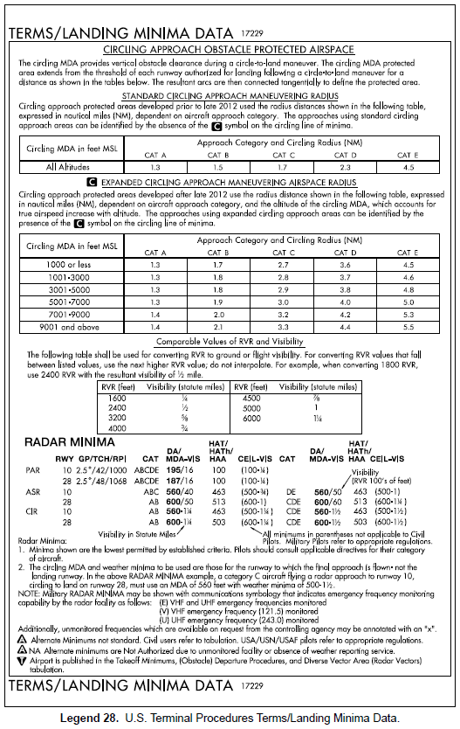
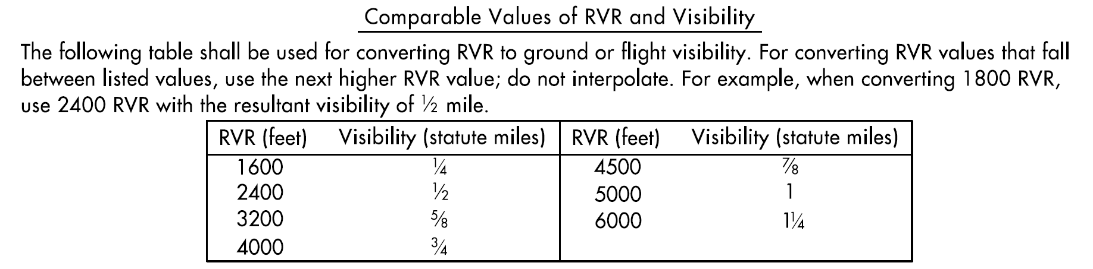
Legend 28
Notes:
Special Use Airspace:
Prohibited Areas are denoted as a blue comb line.
Restricted Areas are denoted as a blue comb line.
Warning Areas are denoted as a blue comb line.
Alert Areas are also denoted as a blue comb line.
Military operations areas (MOA) are denoted as a magenta comb line.

Slide 26
Instrument Approaches
To descend below DH or MDA must see:
Approach lighting but not below 100’ unless red terminating bars are distinctly visible
Threshold/threshold markings/lights
Runway end identifier lights
VASI
Touchdown zone or markings or lights
Runway or runway markings
Runway lights
If Not: GO AROUND!
Notes:
Special Use Airspace:
Prohibited Areas are denoted as a blue comb line.
Restricted Areas are denoted as a blue comb line.
Warning Areas are denoted as a blue comb line.
Alert Areas are also denoted as a blue comb line.
Military operations areas (MOA) are denoted as a magenta comb line.

Slide 27
Instrument Approaches
Airport Surveillance Radar (ASR):
Non-precision
ATC radar provides directional guidance and distance to runway
Controller advises missed approach
Precision Runway Monitor (PRM):
High update-rate radar surveillance system certified to provide simultaneous approaches to closely-spaced runways
Notes:
Special Use Airspace:
Prohibited Areas are denoted as a blue comb line.
Restricted Areas are denoted as a blue comb line.
Warning Areas are denoted as a blue comb line.
Alert Areas are also denoted as a blue comb line.
Military operations areas (MOA) are denoted as a magenta comb line.

Slide 28
Instrument Approaches
RNAV (GPS):
Non-precision
Precision:
Localizer Performance with Vertical Guidance (LPV) – requires GPS/WAAS (Wide Area Augmentation System)
GBAS – Ground Based Augmentation to GPS, same techniques as ILS
RNP with Arc
Approach MUST in aircraft database
Notes:
Special Use Airspace:
Prohibited Areas are denoted as a blue comb line.
Restricted Areas are denoted as a blue comb line.
Warning Areas are denoted as a blue comb line.
Alert Areas are also denoted as a blue comb line.
Military operations areas (MOA) are denoted as a magenta comb line.

Slide 29
Landing

Slide 30
Landing
Landing priority “first come first served”
If tower controlled exit first suitable taxiway
ATC furnishes braking action as “good,” “fair,” “poor” and “nil”
Increased Landing Weight
10% increase = 21% increase kinetic energy
10% increase = 10% increase landing dist
Notes:
Special Use Airspace:
Prohibited Areas are denoted as a blue comb line.
Restricted Areas are denoted as a blue comb line.
Warning Areas are denoted as a blue comb line.
Alert Areas are also denoted as a blue comb line.
Military operations areas (MOA) are denoted as a magenta comb line.

