Slide 1
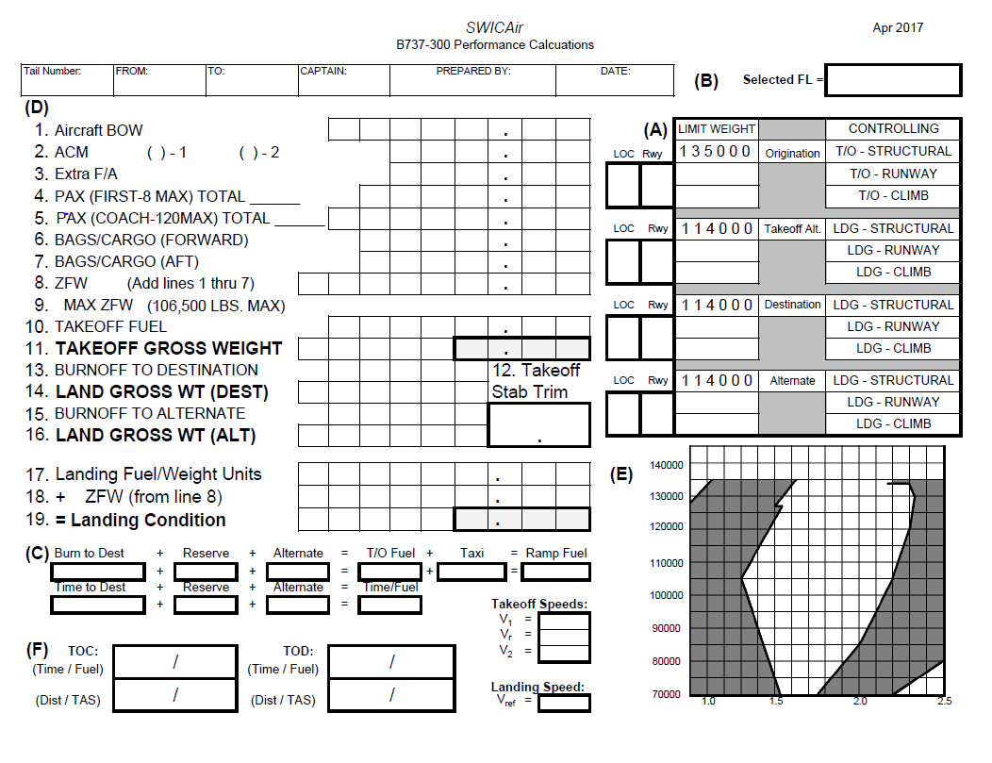
Property of SWIC Air
Manual IFR Flight Plan

Slide 2
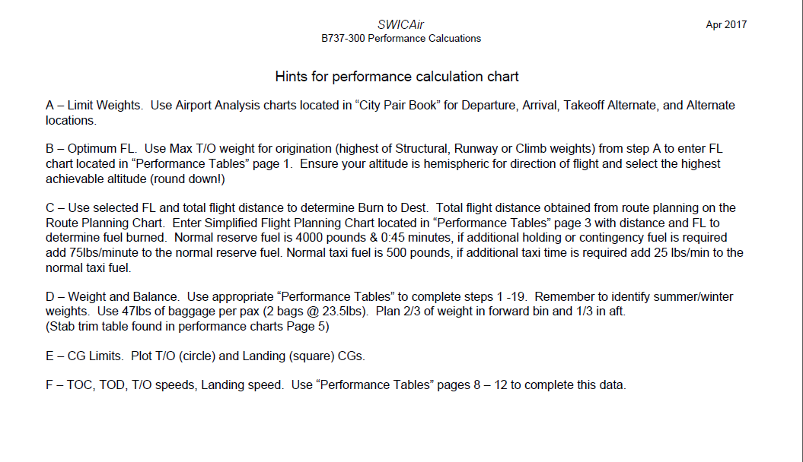
Property of SWIC Air
Manual IFR Flight Plan

Slide 3
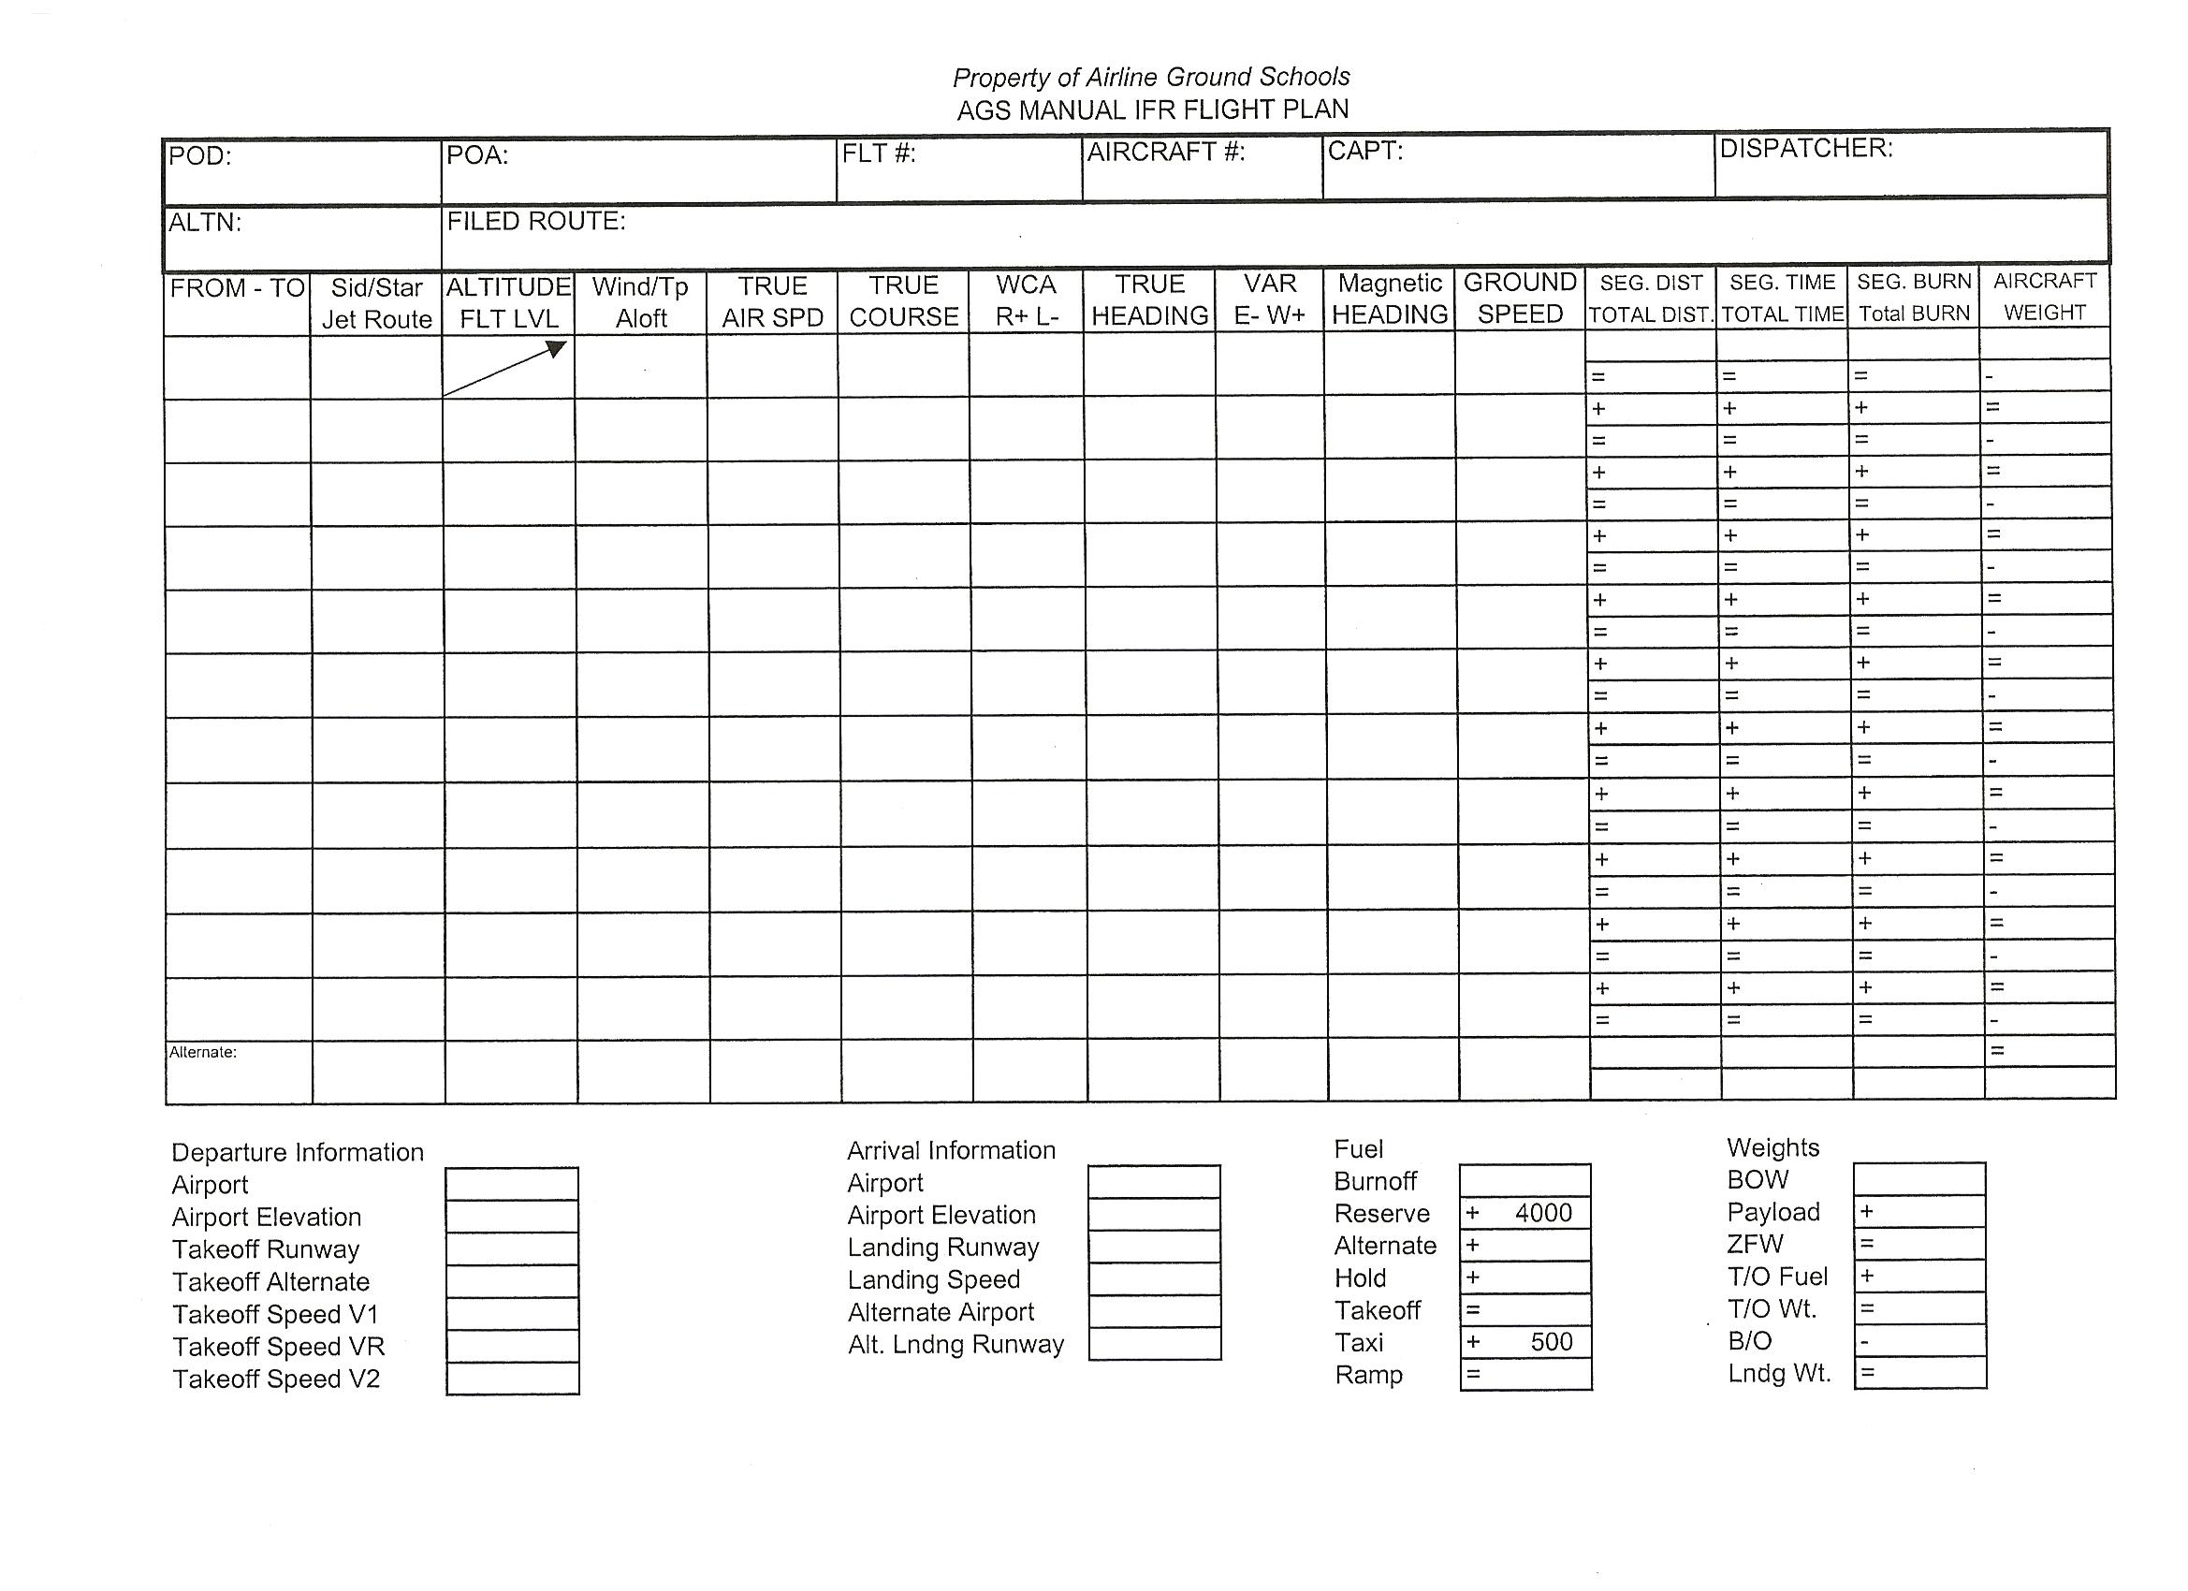
Property of SWIC Air
Manual IFR Flight Plan

Slide 4
