Slide 1
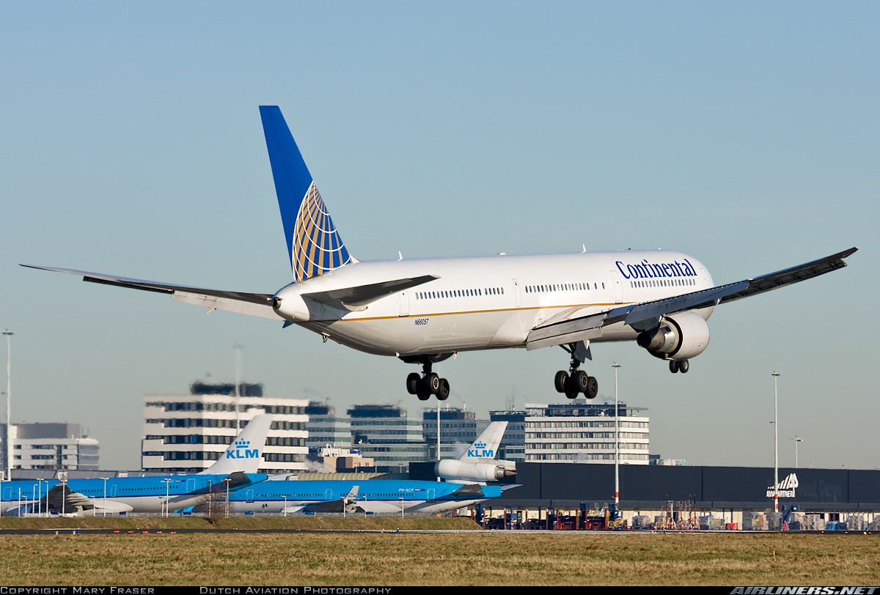
Ops Specs
Notes:
The performance data for takeoff and landing an aircraft can be obtained from the aircraft's flight manual or pilot's operating handbook. The actual performance of an aircraft is affected by many variables which must be taken into account.

Slide 2
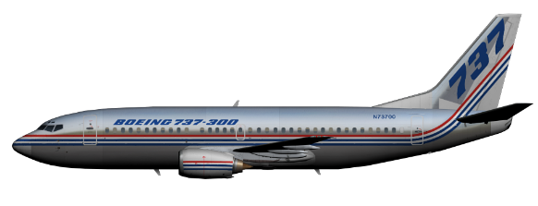

Ops Specs
What is it?
How you are going to operate your airline
Covers things like
  Type of equipment you are going to operate
  Where you are going to operate
  Extent to which VFR is allowed
  Crew training required
  Duty and flight time limitations
  Flight Planning, dispatch, and flight following requirements
Notes:
The Landing Climb Limit Weight is also known as a go-around scenario.
Calculate all three and use the lower number.

Slide 3

Ops Specs Part A
General Information
Authorized operations
Definitions
Airplane authorizations
Operations authorizations
Exemptions (3585)
Operational Control
Notes:
The Landing Climb Limit Weight is also known as a go-around scenario.
Calculate all three and use the lower number.

Slide 4
Ops Specs Part B
Enroute
Class 1 Navigation
Area Navigation (RNAV)
  Considerations with one RNAV System
  Q Routes
Notes:
The Landing Climb Limit Weight is also known as a go-around scenario.
Calculate all three and use the lower number.

Slide 5
Ops Specs Part B
Enroute
  Reduced Vertical Separation Minimum (RVSM)
Authorized Areas of Operations
Notes:
The Landing Climb Limit Weight is also known as a go-around scenario.
Calculate all three and use the lower number.

Slide 6

Ops Specs Part C
Terminal Procedures
Special Pilot-in-Command Airports
Authorized Approaches
Non-Precession Approach Visibility and RVR
High Minimum Pilot-in-Command
  121.652
    PIC Less than 100 hrs
Notes:
The Landing Climb Limit Weight is also known as a go-around scenario.
Calculate all three and use the lower number.

Slide 7
Ops Specs Part C
Terminal Procedures
Alternate WX Mins
    One nav facility available
    Two or more nav facilities available
  Standard Takeoff Minimums
  RNAV Departures and Arrivals
    SIDS and STARS
Notes:
The Landing Climb Limit Weight is also known as a go-around scenario.
Calculate all three and use the lower number.

Slide 8
Ops Specs Part C
Terminal Procedures
No Operating Control Tower
  Only for Non-scheduled passenger and all-cargo ops
Authorized Airports
Precession Approach Visibility and RVR
Notes:
The Landing Climb Limit Weight is also known as a go-around scenario.
Calculate all three and use the lower number.

Slide 9
Ops Specs Part C
Terminal Procedures
Circle-to-Land Approaches
  Not in IFR conditions
Lower that standard T/O mins
Notes:
The Landing Climb Limit Weight is also known as a go-around scenario.
Calculate all three and use the lower number.

Slide 10

QUIZ
Don’t Crash and Burn
Notes:
The Landing Climb Limit Weight is also known as a go-around scenario.
Calculate all three and use the lower number.

