Slide 1
Aircraft Dispatcher
Oral Test Questions, Part 1
010115
Notes:
GOM references apply to the ASTAR General Operations Manual dated 03/05/04
1

Slide 2
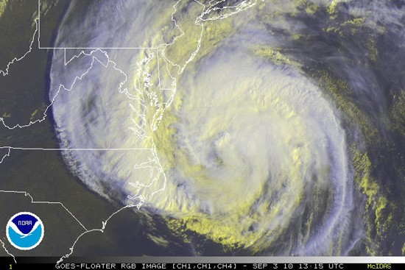
51. Is low pressure an area of convergence or divergence?
Notes:
2

Slide 3
51. Is low pressure an area of convergence or divergence?
Convergence;
flowing inward;
Counter-clockwise
Notes:
3

Slide 4

52. What type of clouds would you notice along a warm front?
Notes:
4

Slide 5
52. What type of clouds would you notice along a warm front?
Stratiform (stable) clouds with the possibility of embedded thunderstorms.
Notes:
5

Slide 6

53. Name a few characteristics of a warm front.
Notes:
6

Slide 7
53. Name a few characteristics of a warm front.
Stratus clouds gradually becoming lower;
Extensive geographical coverage;
Slow-moving;
Continuous precipitation;
Rime ice in clouds.
Notes:
Type of Icing is determined by the size of the water droplet. Stratus clouds produce small droplets and cumulus produce large.
7

Slide 8
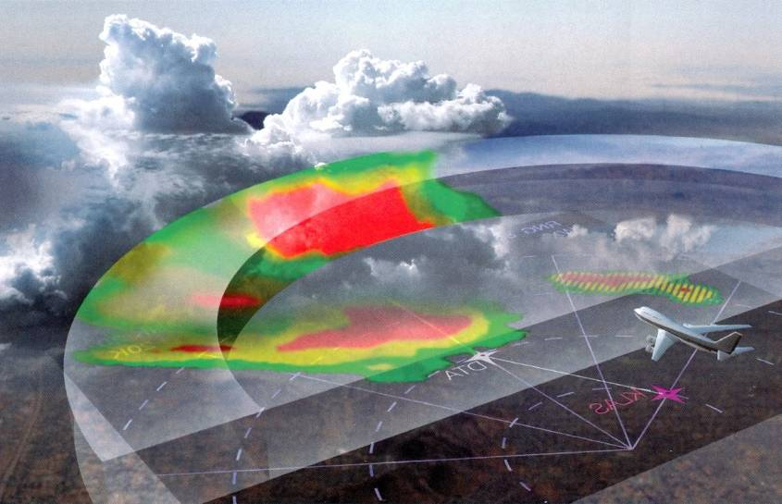
54. What are the characteristics of a cold front?
Notes:
8

Slide 9
54. What are the characteristics of a cold front?
Cumulonimbus clouds;
Instability;
Narrow geographical coverage;
Fast-moving (up to 30 mph);
Clear ice in clouds;
Intermittent precipitation.
Notes:
9

Slide 10
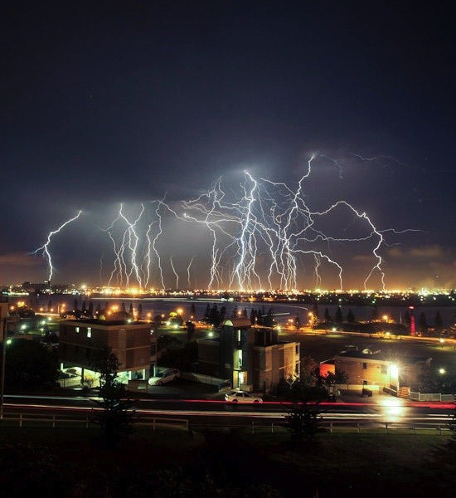
55. What is a dry line?
Notes:
10

Slide 11
55. What is a dry line?
Moist air flowing north from the Gulf of Mexico abuts drier, cooler, denser air flowing eastward;
The only difference between air masses is moisture.
Spawns squall lines and tornadoes in the central plains states.
Also known as a dewpoint front.
Notes:
11

Slide 12

56. What are squall lines?
Notes:
12

Slide 13
56. What are squall lines?
Unstable, narrow, non-frontal bands of convective activity usually found up to 150 miles in advance of a cold front.
Notes:
13

Slide 14

57. Where are you likely to find CAT?
Notes:
14

Slide 15
57. Where are you likely to find CAT?
In an upper trough on the cold (polar) side of the jet stream.
Notes:
15

Slide 16

58. What weather providers are you authorized?
Notes:
Ops Specs
16

Slide 17
58. What weather providers are you authorized?
Ops Specs A010
National Weather Service (NWS),
WSI,
FSS,
Jeppesen
Notes:
17

Slide 18
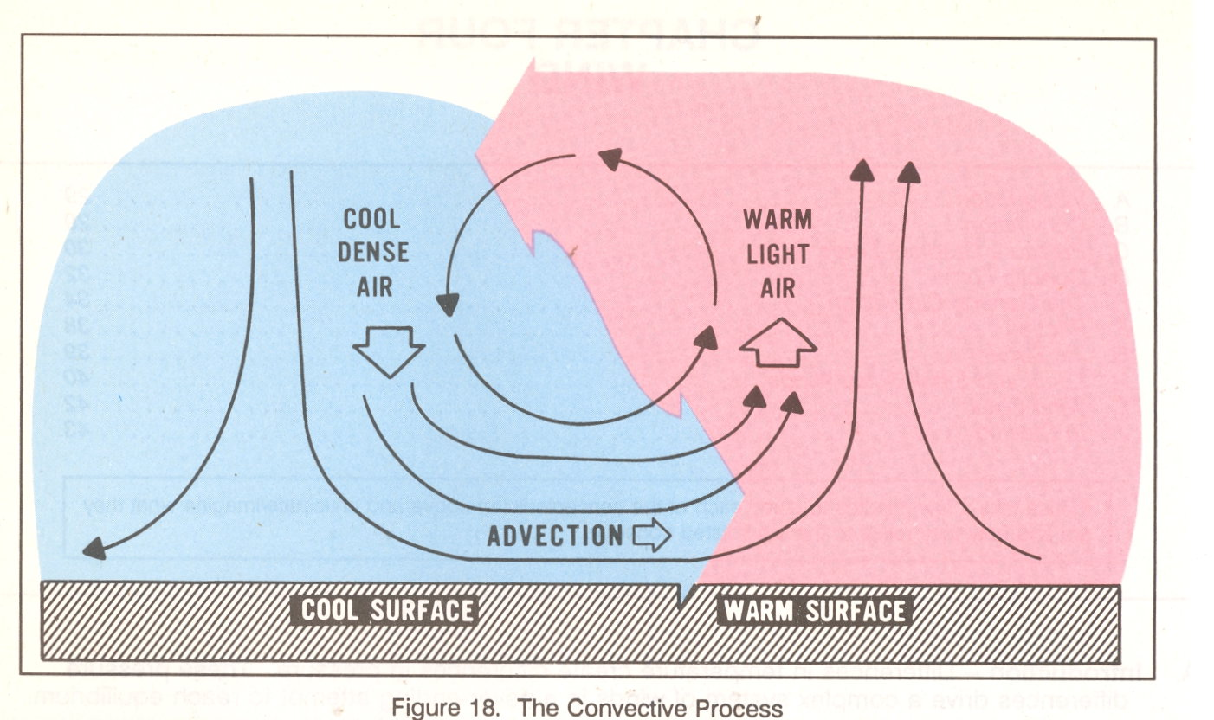
59. How can you predict potential for windshear in weather reports and forecasts?
Notes:
GOM
18

Slide 19
59. How can you predict potential for windshear in weather reports and forecasts?
Isobars close together on the charts
Thunderstorm reports
PIREP
METARS
TAFs
Center Weather Advisories (CWA)
SIGMETs
AIRMETs
Notes:
19

Slide 20
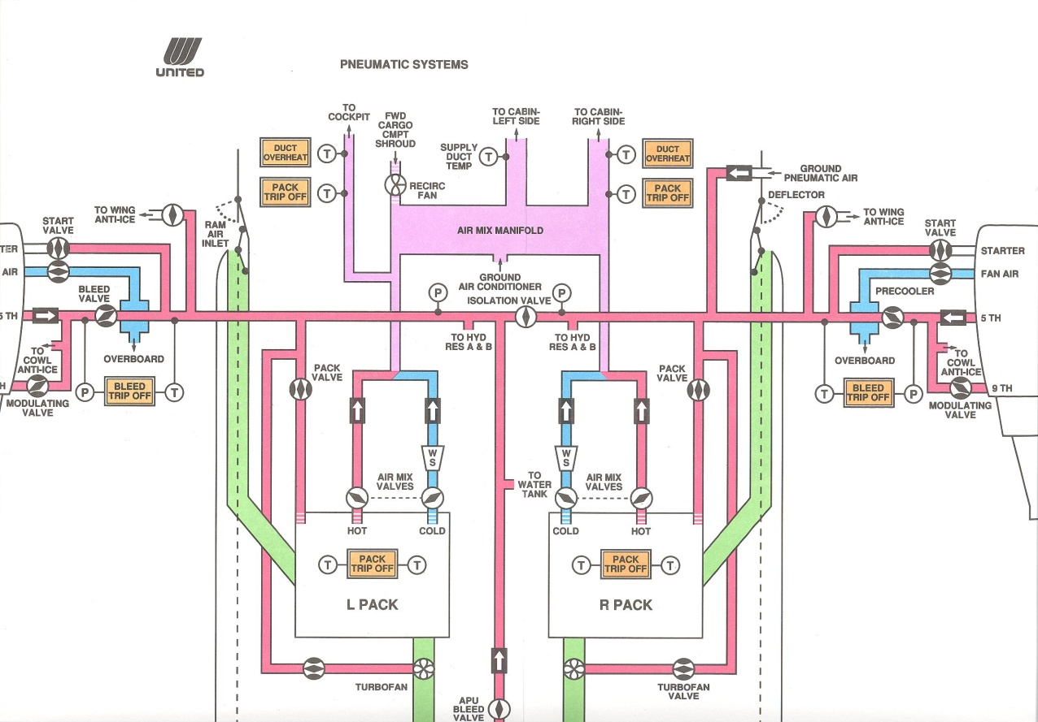
60. What does the pneumatic system do? Describe how it works.
Notes:
20

Slide 21
60. What does the pneumatic system do? Describe how it works.
Compressed bleed air from the engines can be used to start engines;
pressurize the cabin, hydraulics and water systems;
heat and cool the cabin; and
provide anti-ice protection.
Aircraft Operating Manual (AOM)
Notes:
21

Slide 22
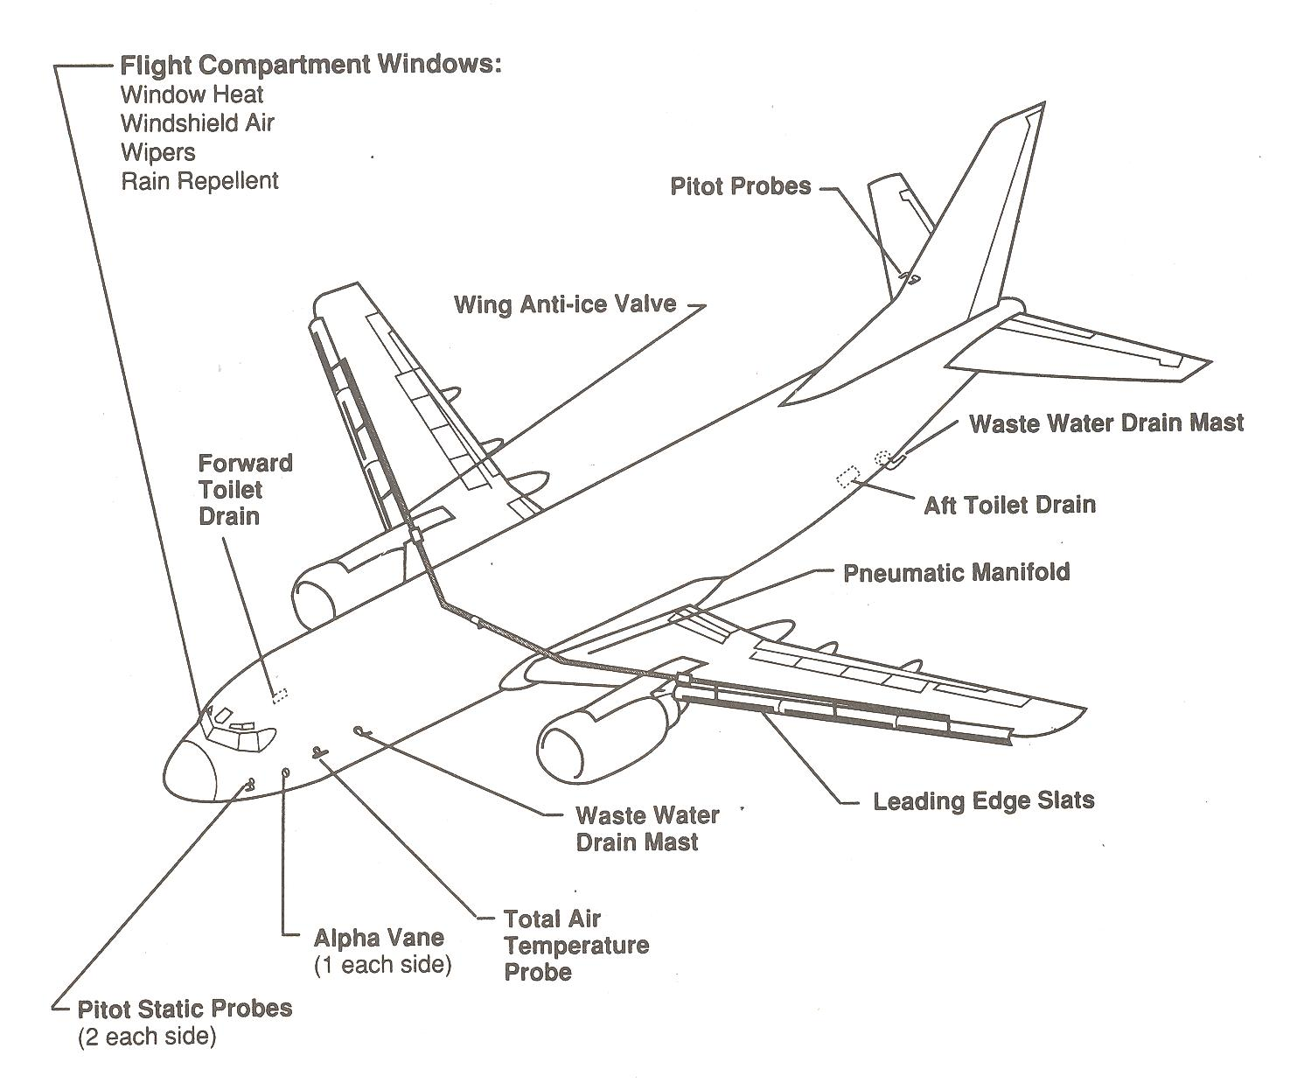
61. Do we have anti-ice or deice on the B737?
Notes:
22

Slide 23
61. Do we have anti-ice or deice on the B737? (AOM & Performance Manual)
Anti-ice from hot bleed air –
Engine stages 5 and 9.
Is there a performance penalty when using anti-ice?
Yes, subtract a few pounds of payload – bottom of Airport Analysis page
(you don’t have this data).
Notes:
23

Slide 24
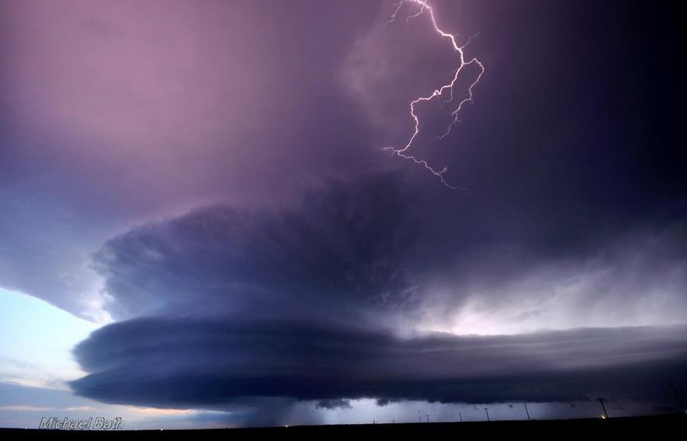
62. Maintenance says the weather radar is broken and thunderstorms are forecast along the route.
What to do?
Notes:
MEL
24

Slide 25
62. Maintenance says the weather radar is broken and thunderstorms are forecast along the route.
What to do?
Reroute the airplane;
Substitute a different aircraft;
Delay the flight until it is fixed;
Cancel the flight.
MEL Manual
Notes:
25

Slide 26
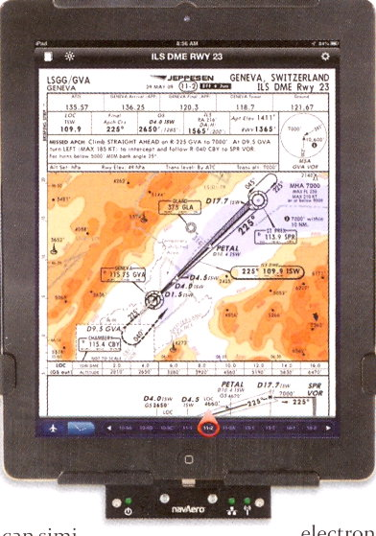
63. What is standard Cat I landing minima?
Notes:
Ops Specs
26

Slide 27
63. What is standard Cat I landing minima?
200 ft ceilings and 2400 RVR (1/2 SM vis).
Ops Specs C074 Category I, ILS Approach Procedures & IFR Landing Minimums – All Airports
Do we need both ceiling & visibility in Part 121 operations?
Notes:
Ops Specs and FAR 121.651
27

Slide 28
63. What is standard Cat I landing minima?
200 ft ceilings and 2400 RVR (1/2 SM vis).
Ops Specs C074 Category I, ILS Approach Procedures & IFR Landing Minimums – All Airports
Do we need both ceiling & visibility in Part 121 operations?
No, only the visibility is required.
FAR 121.651 Takeoff & Landing Weather Minimums: IFR…
Are we authorized Cat II approaches?
Notes:
Ops Specs
28

Slide 29
63. What is standard Cat I landing minima?
200 ft ceilings and 2400 RVR (1/2 SM vis).
Ops Specs C074 Category I, ILS Approach Procedures & IFR Landing Minimums – All Airports
Do we need both ceiling & visibility in Part 121 operations?
No, only the visibility is required.
FAR 121.651 Takeoff & Landing Weather Minimums: IFR…
Are we authorized Cat II approaches?
No, not in our Ops Specs.
Ops Specs Chap. 2.2 p. A4-3 The certificate holder is not authorized…
Notes:
29

Slide 30
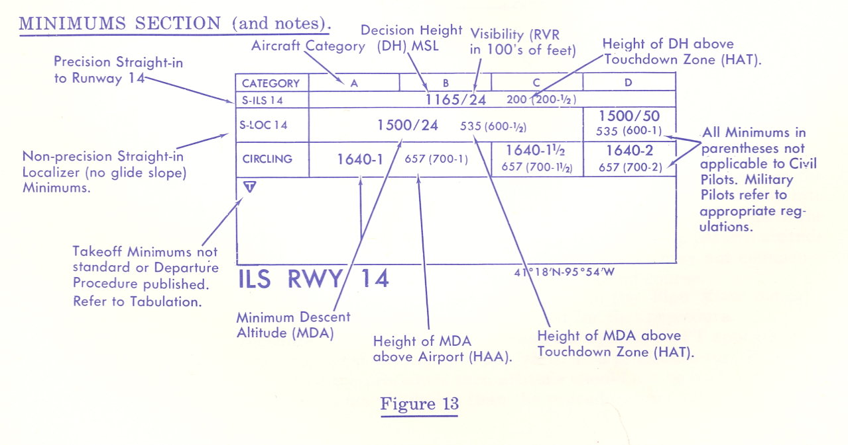
64. What are the alternate minimums for a senior captain and a junior captain?
Notes:
FAR 121.652
30

Slide 31
64. What are the alternate minimums for a senior captain and a junior captain?
Senior - The minimums on the approach chart.
Junior - Never less than 300 and 1.
FAR 121.652 Landing Weather Minimums: IFR
Notes:
31

Slide 32
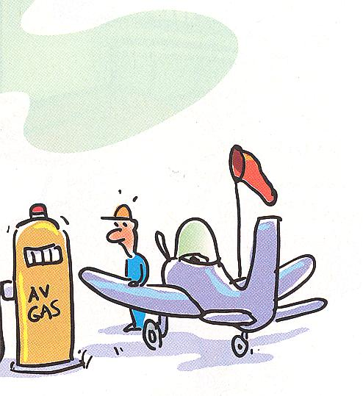
65. What are the fuel requirement for a domestic flight?
Notes:
FAR 121.639
32

Slide 33
65. What are the fuel requirement for a domestic flight?
Fuel to the destination;
Fuel to the most distant alternate, if required;
Fuel for 45 minutes (reserves).
Part 121.639 Fuel Supply: All Domestic Operations
Notes:
33

Slide 34
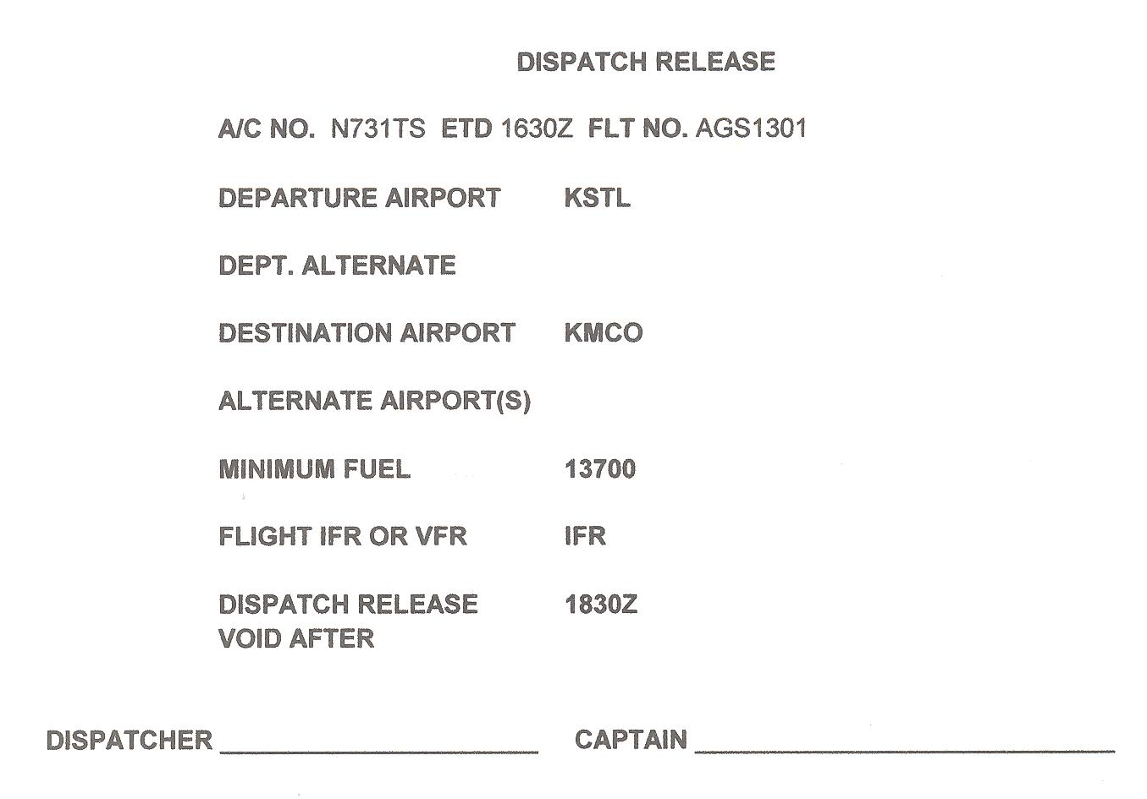
66. What must the dispatch release contain?
Notes:
GOM and FAR 121.687
34

Slide 35
66. What must the dispatch release contain?
Part 121.687 Dispatch Release: Flag & Domestic Operations
Aircraft ID,
Trip number,
Departure airport,
Intermediate stops,
Destination and any alternate airports,
IFR or VFR,
Minimum fuel supply,
Weather reports and forecasts.
Notes:
35

Slide 36
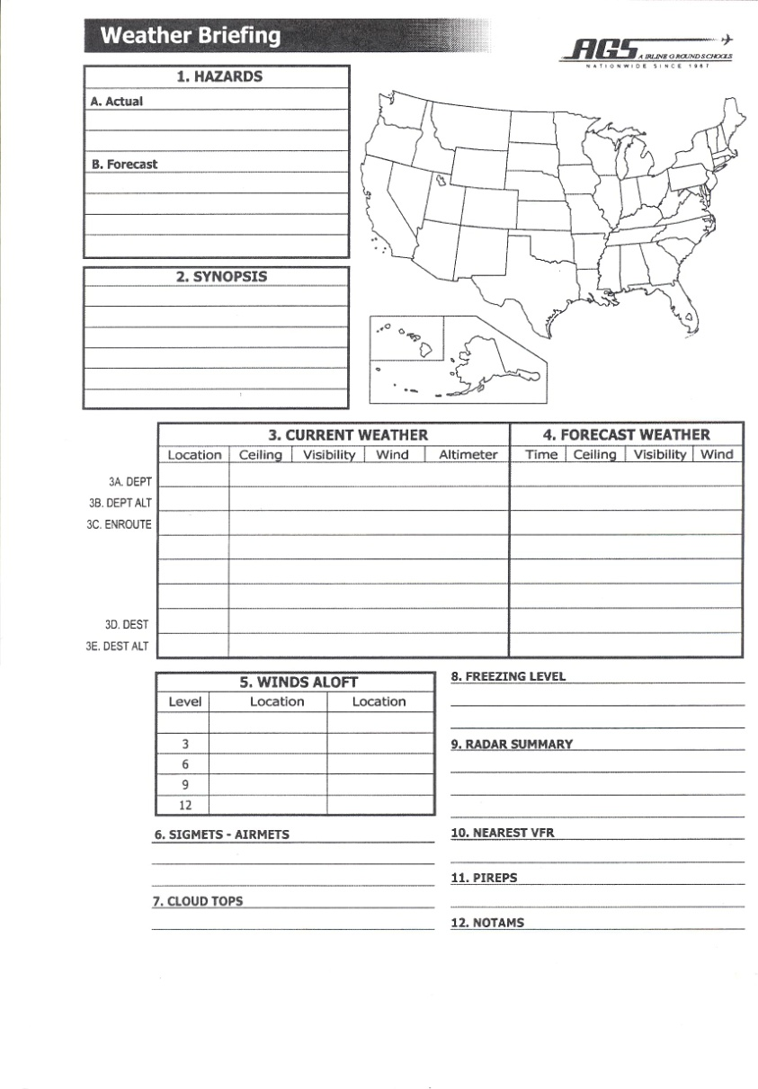
67. In addition to the dispatch release, what do you give the captain?
Notes:
FAR 121.601 and 121.687
36

Slide 37
67. In addition to the dispatch release, what do you give the captain?
Reports on airport conditions and nav facilities;
Weather reports and forecasts.
Part 121.601 Aircraft Dispatcher Info to PIC: Domestic & Flag Operations
121.687 Dispatch Release: Flag & Domestic Operations
Notes:
37

Slide 38
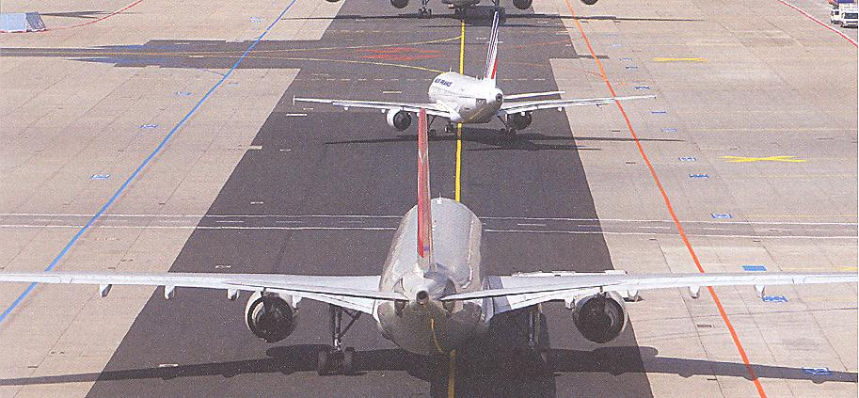
68. If the crew has to wait in line for takeoff & are now 200 lb less than what is required for takeoff, what must they do?
Notes:
38

Slide 39
68. If the crew has to wait in line for takeoff & are now 200 lb less than what is required for takeoff, what must they do?
Call dispatch and ask Load Planning to recompute required fuel if they do not have contingency fuel on board.
May need to taxi back for more fuel.
FAR 121.189 Airplanes: Turbine Engine Powered: Takeoff Limitations
Notes:
39

Slide 40
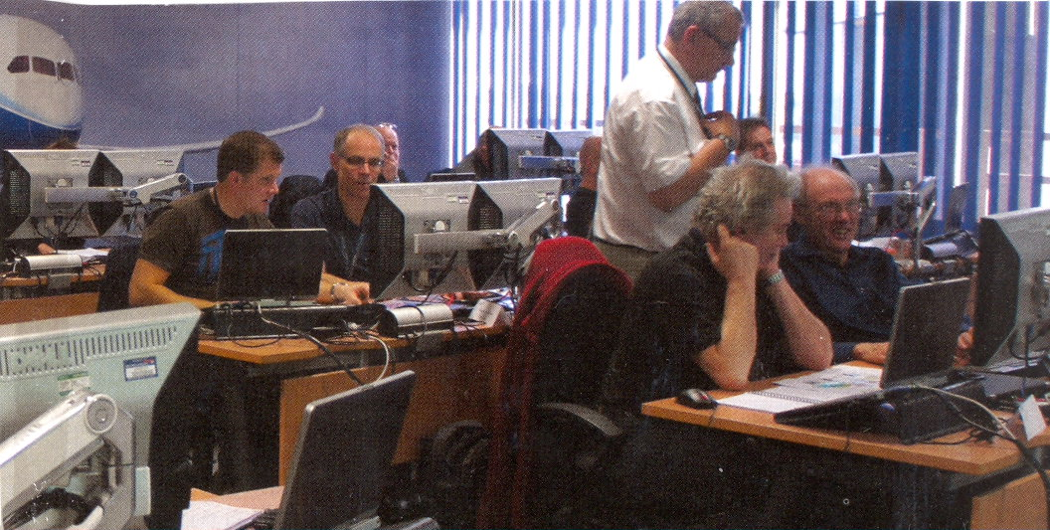
69. You become aware that an alternate on the release is now below minimums. The flight has departed. What do you do?
Notes:
FAR 121.619 and FAR 121.625
40

Slide 41
69. You become aware that an alternate on the release is now below minimums. The flight has departed. What do you do?
Call the crew enroute and suggest a new alternate.
Then initiate an amendment to the release.
FAR 121.619 Alternate Airport For Destination: IFR…Domestic
FAR 121.625 Alternate Airport Weather Minimums
Notes:
41

Slide 42
70. In what ways can you communicate with the crew enroute?
Notes:
42

Slide 43
70. In what ways can you communicate with the crew enroute?
VHF company station radio.
HF radio through an intermediary such as Delta Radio, AIRINC, etc.
SATCOM.
SELCAL.
ACARS.
Cell phone as a last resort.
GOM Chap 5.6 Communications/Reporting Requirements
Notes:
43

Slide 44
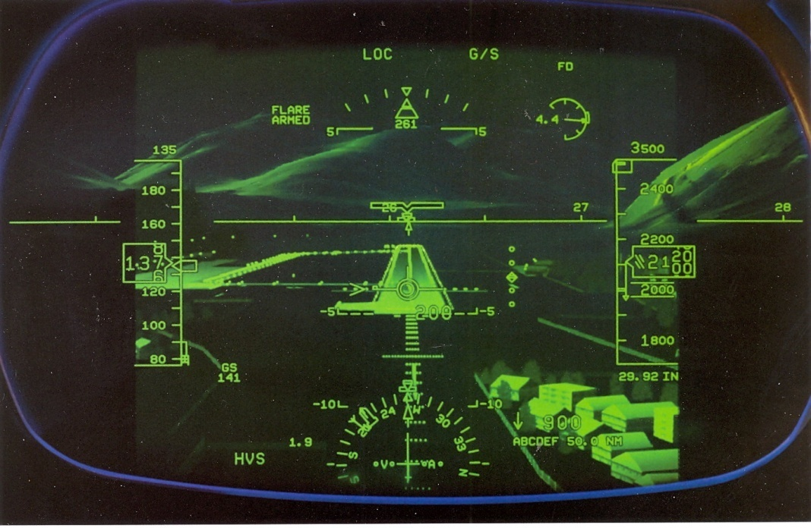
71. What is the difference between a precision & non-precision approach?
Notes:
44

Slide 45
71. What is the difference between a precision & non-precision approach?
Precision – ILS of 200 ft & 2400 RVR
(1/2 SM).
Non-precision – No glideslope meaning higher minimums (NDB, VOR, LOC).
AIM Chap 1 Air Navigation
Notes:
45

Slide 46

72. Are pilots required to notify Dispatch of their arrival and departure times?
Notes:
46

Slide 47
72. Are pilots required to notify Dispatch of their arrival and departure times?
Yes, if they do not have ACARS installed.
GOM Chap 8.9 p. 6
Aircraft Communications and
Reporting System
Notes:
47

Slide 48
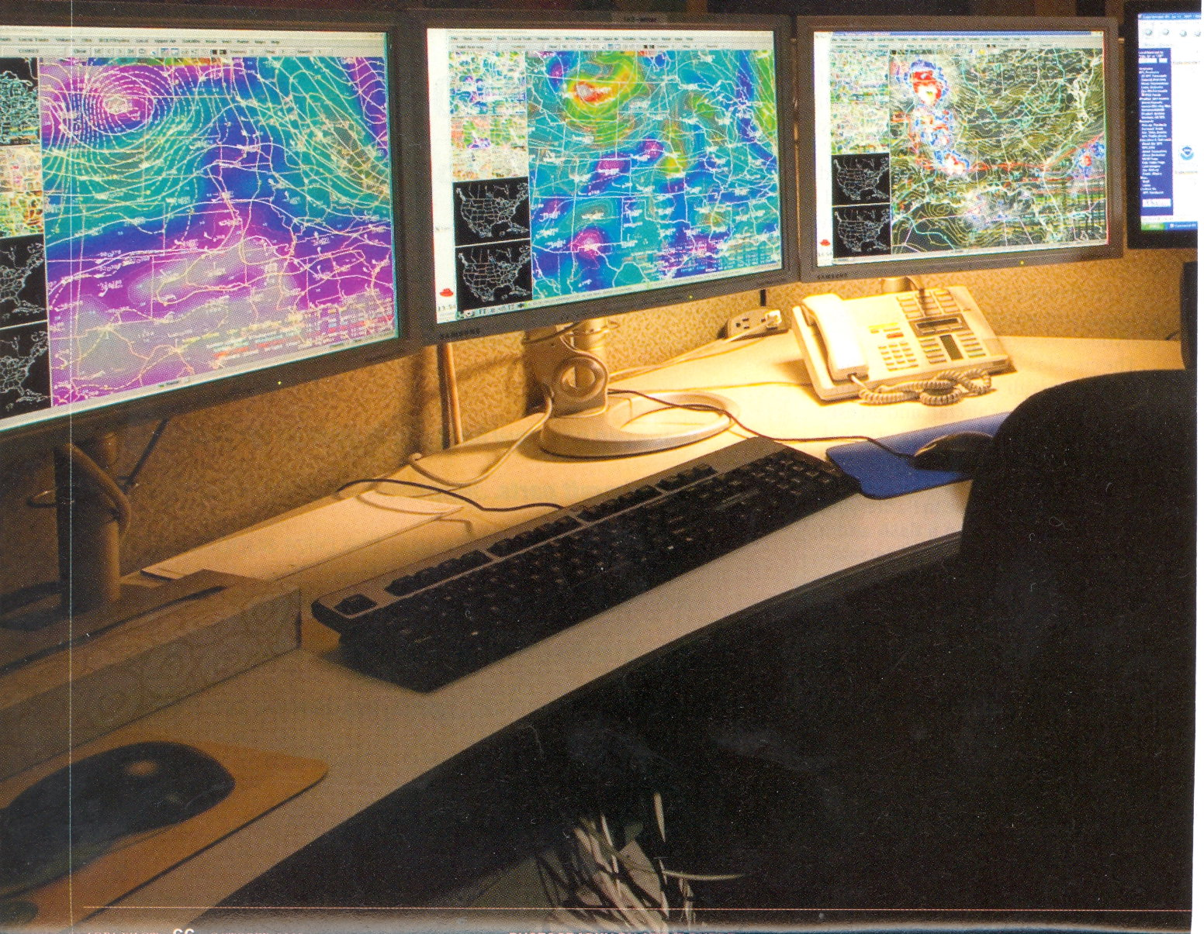
73. What is EWINS?
Notes:
AIM 7-1-3 p. 892
48

Slide 49
73. What is EWINS?
Enhanced Weather Information Service
FAA-approved program allowing dispatchers with additional weather training to issue forecasts.
AIM 7-1-3
Notes:
49

Slide 50
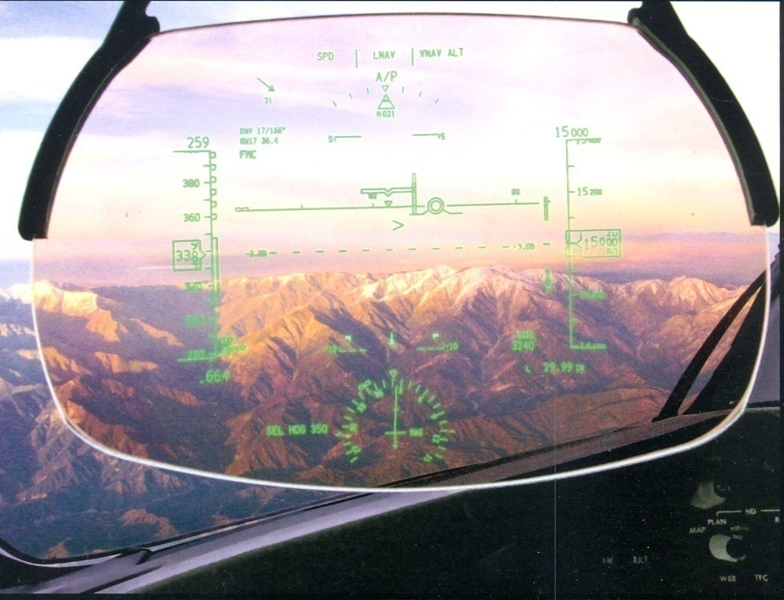
74. Does a SID guarantee obstacle clearance on departure?
Notes:
50

Slide 51
74. Does a SID guarantee obstacle clearance on departure?
No, pilots must compute their climb rate before takeoff.
DPs and ODPs guarantee obstacle clearance.
Instrument Procedures Handbook
Notes:
51

Slide 52
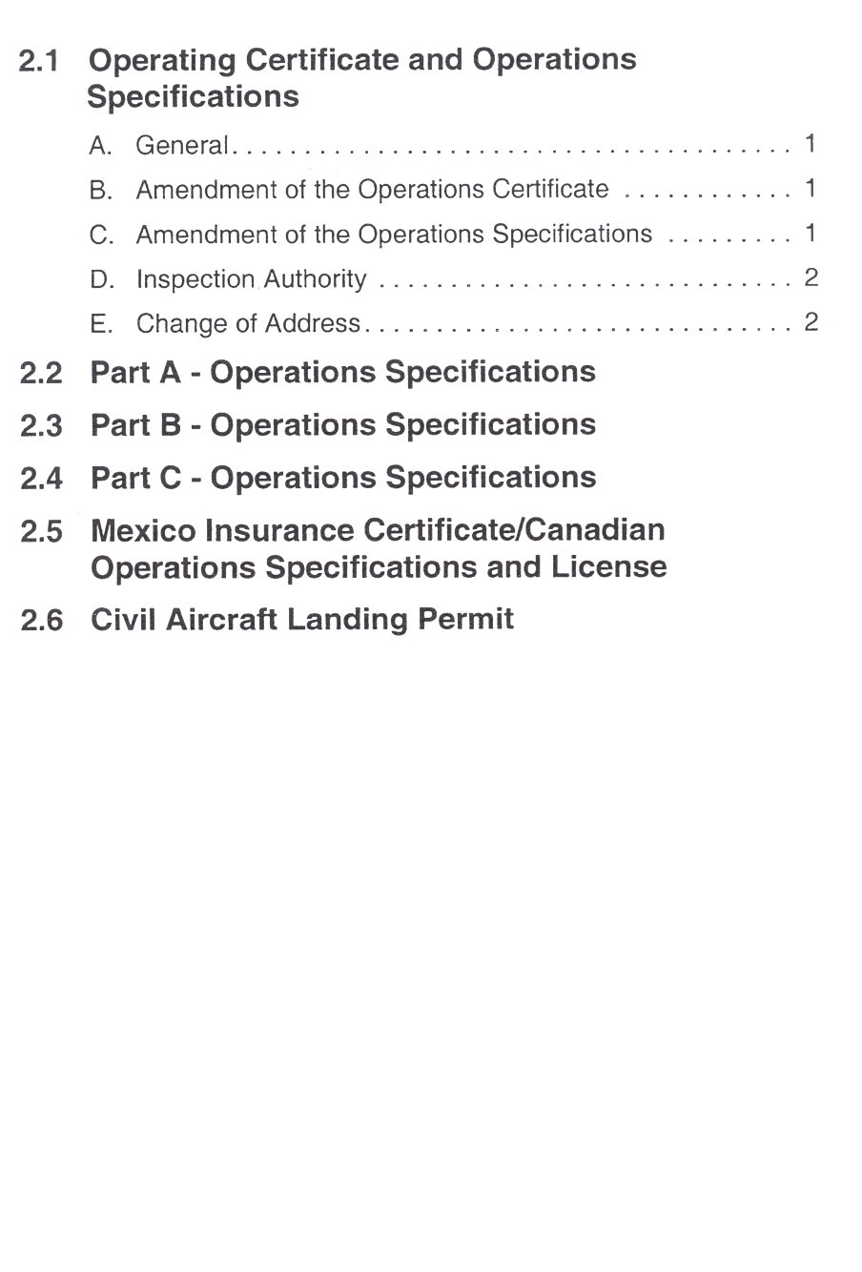
75. What is the lowest RVR allowed for takeoff in our Ops Specs?
Notes:
Ops Specs C078
52

Slide 53
75. What is the lowest RVR allowed for takeoff in our Ops Specs?
600, 600, & 600 if the runway allows.
Some runways are approved for 300 and 500 RVR but we don’t have that approval.
It requires additional pilot training and a Heads-Up Display (HUD) in the cockpit.
Ops Specs C078 IFR Lower Than Standard Takeoff Minimums…
Notes:
53

Slide 54
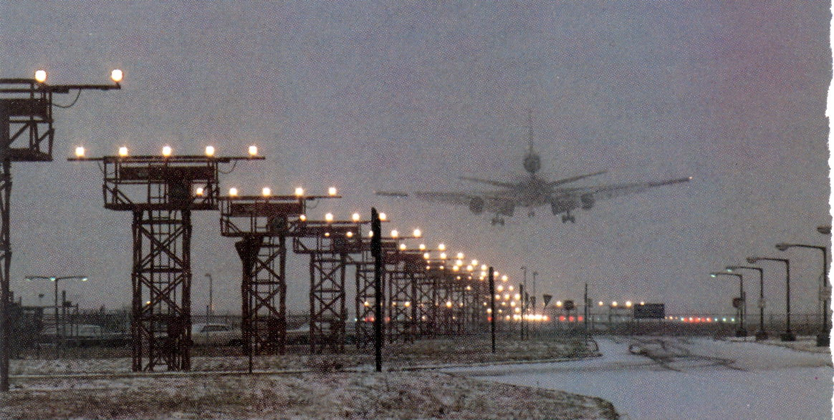
76. What is another word for charters in Part 121 operations?
Notes:
54

Slide 55
76. What is another word for charters in Part 121 operations?
Non-scheduled (Supplemental).
The other types of operations are:
Domestic, Flag, and Commercial Operator.
Ops Specs A030
Supplemental Operations
Notes:
55

Slide 56

77. What is the antidote for someone with a Macho (or Macho-ette) attitude?
Notes:
56

Slide 57
77. What is the antidote for someone with a Macho (or Macho-ette) attitude?
Taking chances is foolish.
The other personality types are:
Anti-authority
Impulsivity
Invulnerability
Resignation
Notes:
57

Slide 58

78. Why do we experience a longer takeoff run at high elevation airports?
As pressure increases with no temp change, what happens to density altitude?
Notes:
58

Slide 59
78. Why do we experience a longer takeoff run at high elevation airports?
Engines produce less power in less dense air.
As pressure increases with no temp change,
density altitude increases.
DA = PA corrected for temperature.
Higher OAT means higher pressure.
Performance Manual
Notes:
59

Slide 60
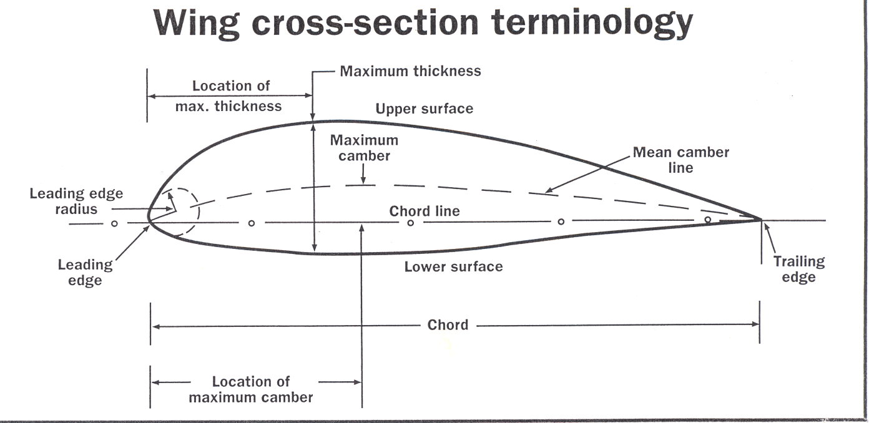
79. What is angle of attack (AOA)?
Notes:
60

Slide 61
79. What is angle of attack (AOA)?
The angle between the chord line and relative wind.
Pilot’s Handbook of Aeronautical Knowledge
Notes:
61

Slide 62
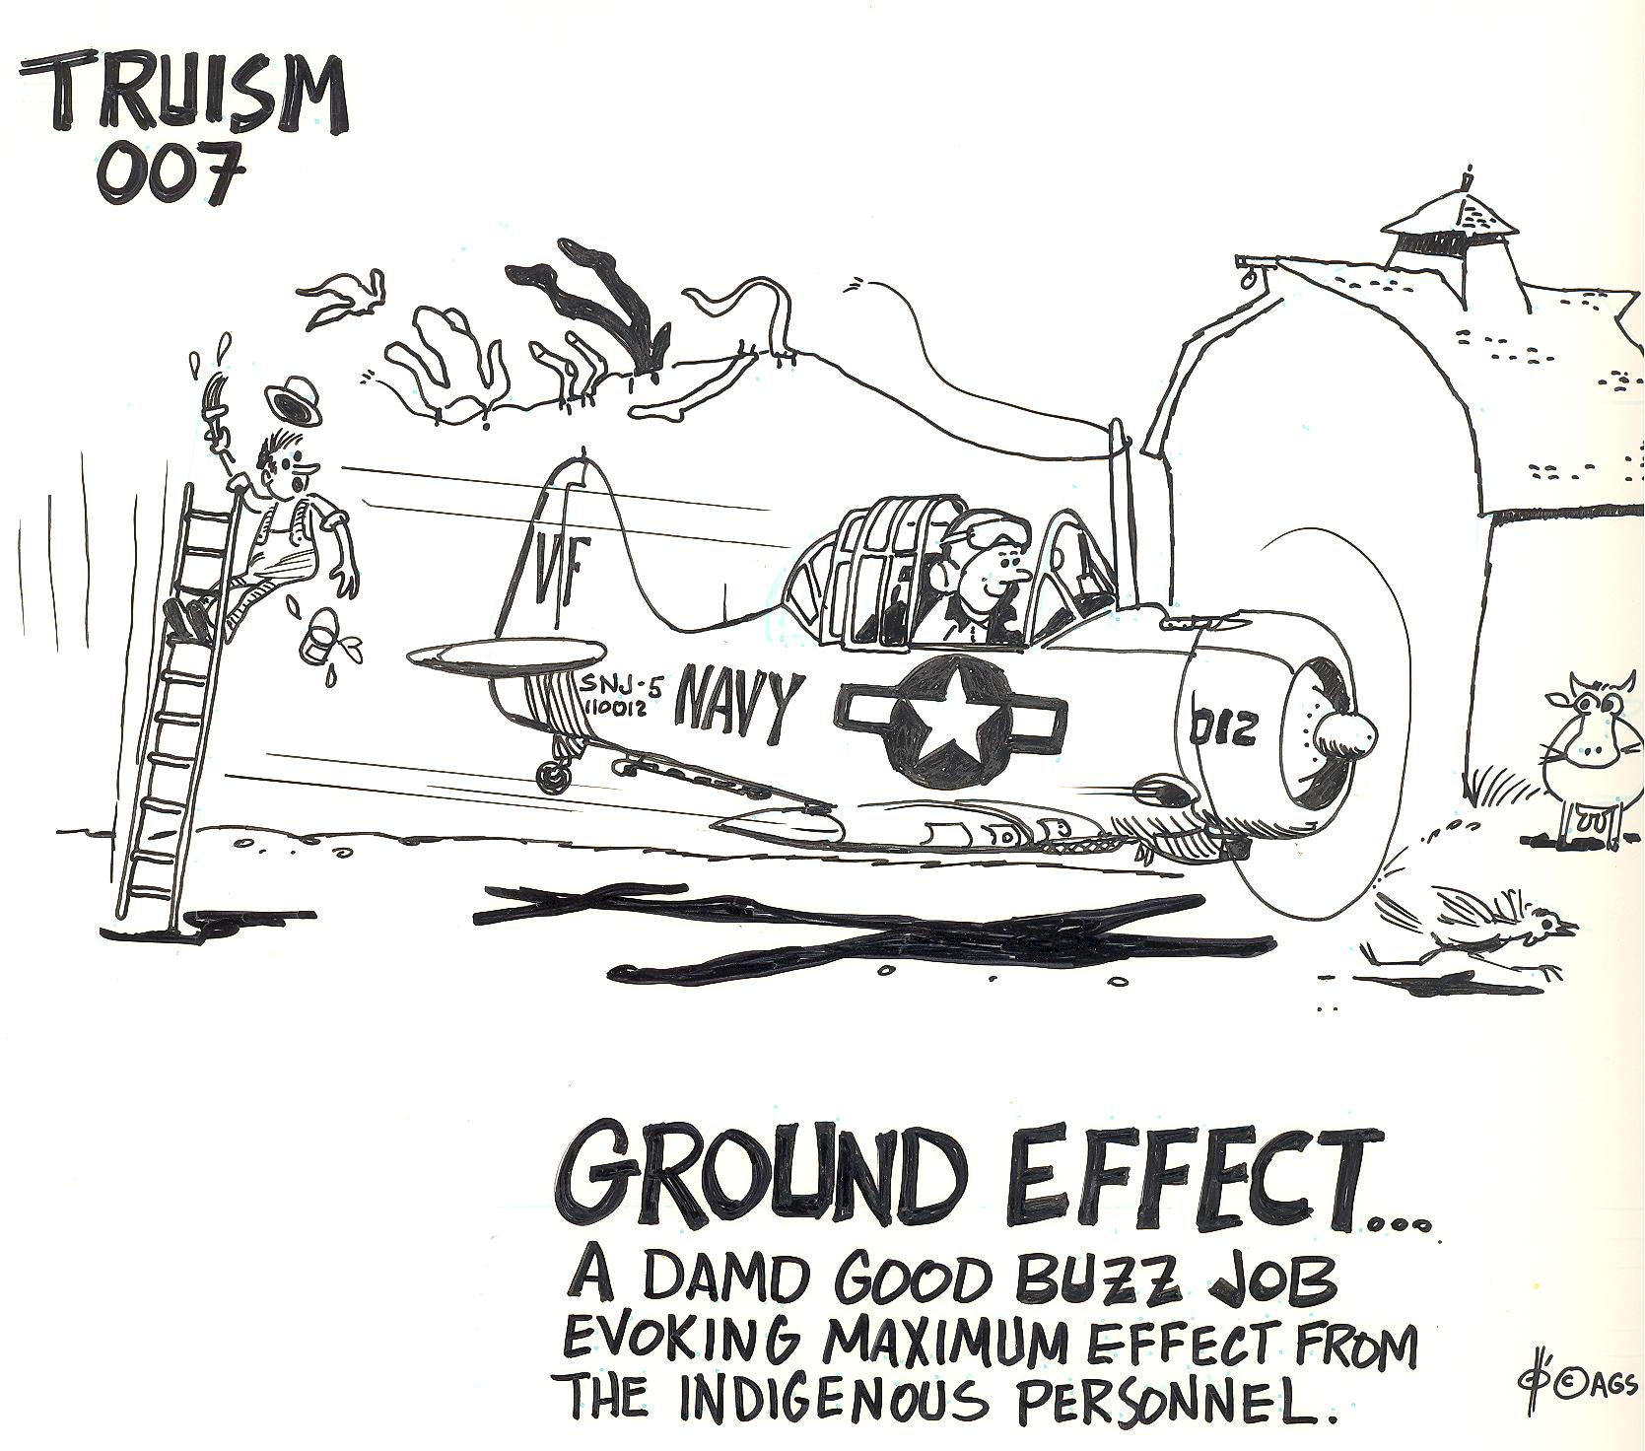
80. What is ground effect?
Notes:
62

Slide 63
80. What is ground effect?
Downwash resulting in induced drag.
Induced drag is caused by lift.
Drag acts opposite to direction of flight & is parallel to relative wind.
The aircraft may float along the runway at a height equal to ½ the wind span by compacting the air under the wing.
Pilot’s Handbook of Aeronautical Knowledge
Notes:
63

Slide 64
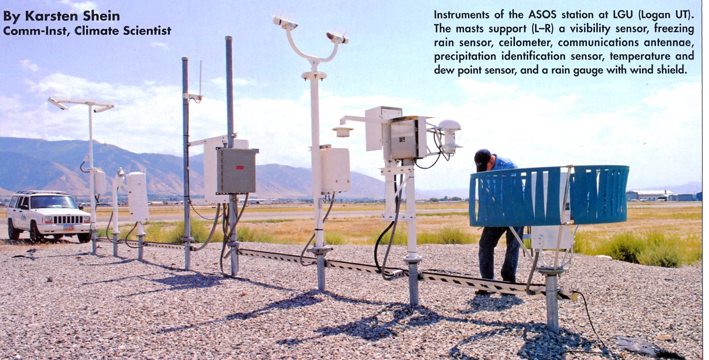
81. What is considered a standard day?
Notes:
AIM Chap. 7
64

Slide 65
81. What is considered a standard day?
At sea level,
29.92 inches of mercury (1013.2 mb).
59 F = 15 C.
AIM Chap. 7
Safety of Flight
Notes:
65

Slide 66
82. What does the pitot probe measure?
Notes:
66

Slide 67
82. What does the pitot probe measure?
Difference between
dynamic and static pressure.
Pilot’s Handbook of Aeronautical Knowledge
Notes:
67

Slide 68
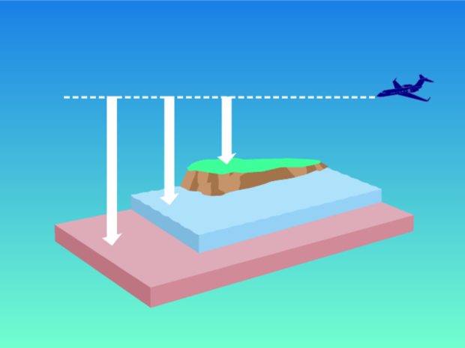
83. What is true altitude?
Pressure True Absolute
Altitude Altitude Altitude
Sea Level
Standard Datum Plane
Sea Level & Standard Datum Plane are equal on a standard day
Notes:
68

Slide 69
83. What is true altitude?
Height above sea level.
Absolute altitude is height above ground.
Service ceiling is the altitude at which the rate of climb = 100 FPM.
Pilot’s Handbook of Aeronautical Knowledge
Notes:
69

Slide 70
84. Communication is an integral part of Dispatch Resource Management. What are some of the other factors?
70
Notes:
70

Slide 71
84. Communication is an integral part of Dispatch Resource Management. What are some of the other factors?
    Workload management
    Decision-making
    Planning
    Crew Coordination
    Situational Awareness
    GOM Chap 5.7 Human Factors & Crew Resource Management
71
Notes:
71

Slide 72
85. What is load factor?
Notes:
72

Slide 73
85. What is load factor?
The ratio of specific load to total weight.
Pilot’s Handbook of Aeronautical Knowledge
Notes:
73

Slide 74
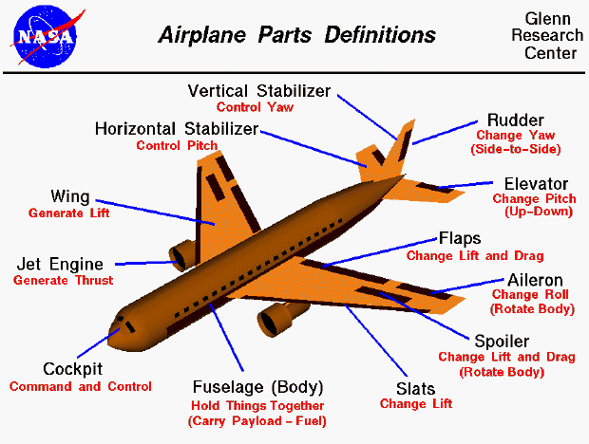
86. What are the primary controls on the aircraft?
Notes:
74

Slide 75
86. What are the primary controls on the aircraft?
Ailerons - Roll - Longitudinal axis
Elevators – Pitch - Lateral axis
Rudder - Yaw - Vertical axis
Pilot’s Handbook of Aeronautical Knowledge
Notes:
75

Slide 76
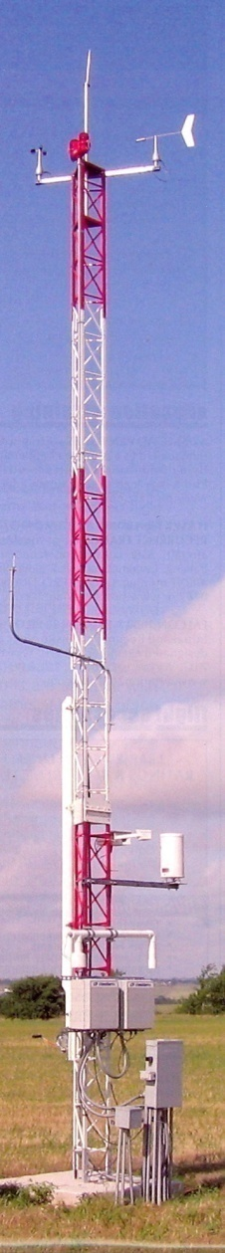
87. Are winds in print form considered True or Magnetic?
Notes:
AIM Chap. 7 Safety of Flight
76

Slide 77
87. Are winds in print form considered True or Magnetic?
True
Winds from the control tower &
ATIS are magnetic just like the
runways.
AIM Chap. 7 Safety of Flight
Notes:
77

Slide 78
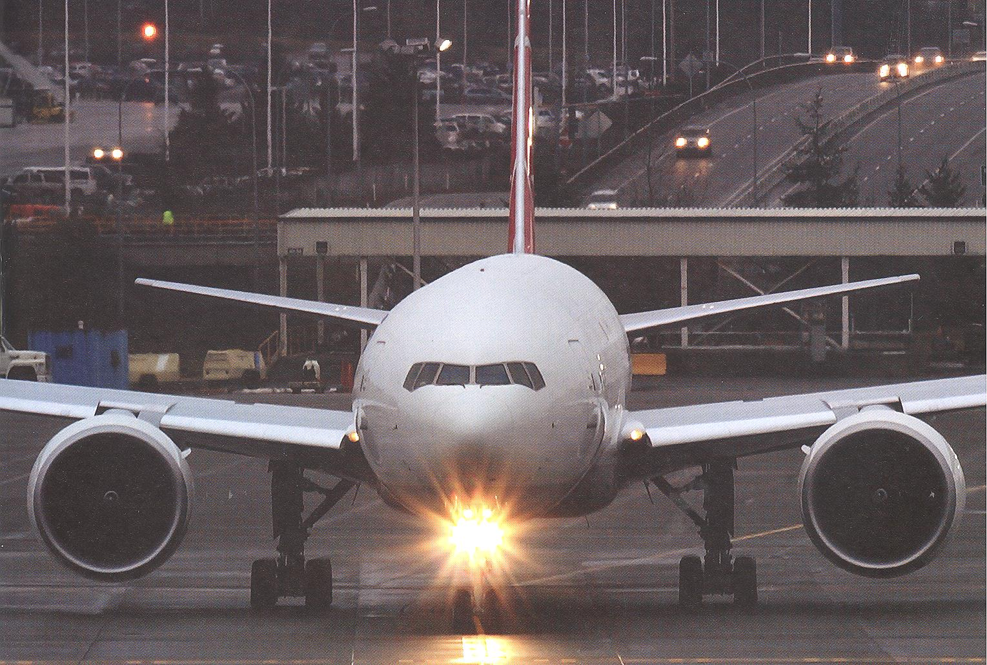
88. What is the definition of Night?
Notes:
78

Slide 79
88. What is the definition of Night?
1 hour after sunset to 1 hour before sunrise.
What is pilotage?
Dead-reckoning?
Pilot’s Handbook of Aeronautical Knowledge
Notes:
79

Slide 80
88. What is the definition of Night?
1 hour after sunset to 1 hour before sunrise.
What is pilotage?
Flight with reference to visual landmarks.
Dead-reckoning?
Flight with reference to wind computations.
Pilot’s Handbook of Aeronautical Knowledge
Notes:
80

Slide 81
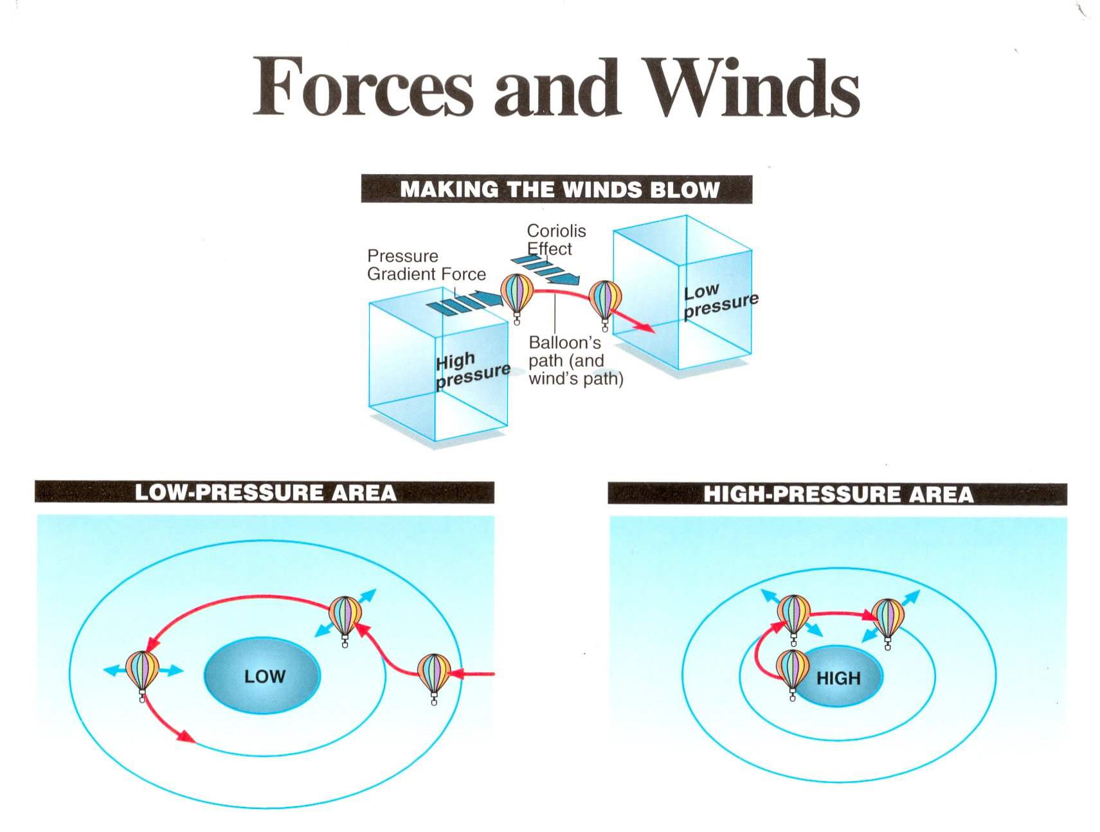
89. What is Coriolis effect?
Notes:
81

Slide 82
89. What is Coriolis effect?
Rotation of the earth causes wind deflection to the right in the Northern Hemisphere.
Notes:
82

Slide 83

90. What causes advection fog?
Notes:
83

Slide 84
90. What causes advection fog?
Warmer air moving horizontally over colder ground.
Example: San Francisco
Warm currents of the Pacific Ocean in winter flowing on shore over colder ground.
Pilot’s Handbook of
Aeronautical Knowledge
Notes:
84

Slide 85
91. Define dewpoint and humidity.
Dewpoint –
Humidity –
Notes:
85

Slide 86
91. Define dewpoint and humidity.
Dewpoint – Temperature at which the air reaches water vapor saturation and precipitates.
Humidity – Moisture in the air at a given temp in ratio to the greatest possible saturation point reference a base line of 100%.
Pilot’s Handbook of Aeronautical Knowledge
Notes:
86

Slide 87
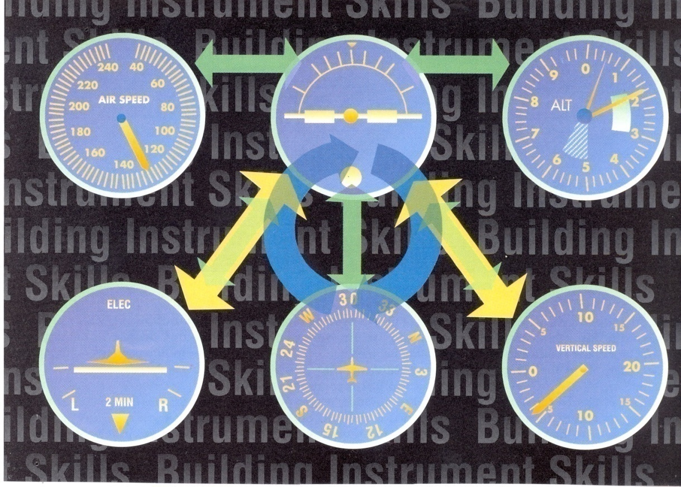
92. Three of the basic flight instruments are controlled by gyros which are:
Notes:
87

Slide 88
92. Three of the basic flight instruments are controlled by gyros which are:
Attitude indicator
Heading indicator
Turn indicator
Pilot’s Handbook of
Aeronautical Knowledge
Notes:
88

Slide 89
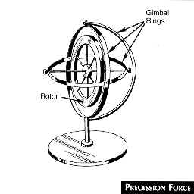
93. A rotating body exhibits gyroscopic properties as per the Law of Motion described by:
Notes:
89

Slide 90
93. A rotating body exhibits gyroscopic properties as per the Law of Motion described by:
Isaac Newton:
A body at rest will remain at rest; or if in motion in a straight line, it will continue in a straight line unless acted upon by an outside force.
Pilot’s Handbook of Aeronautical Knowledge
Notes:
90

Slide 91
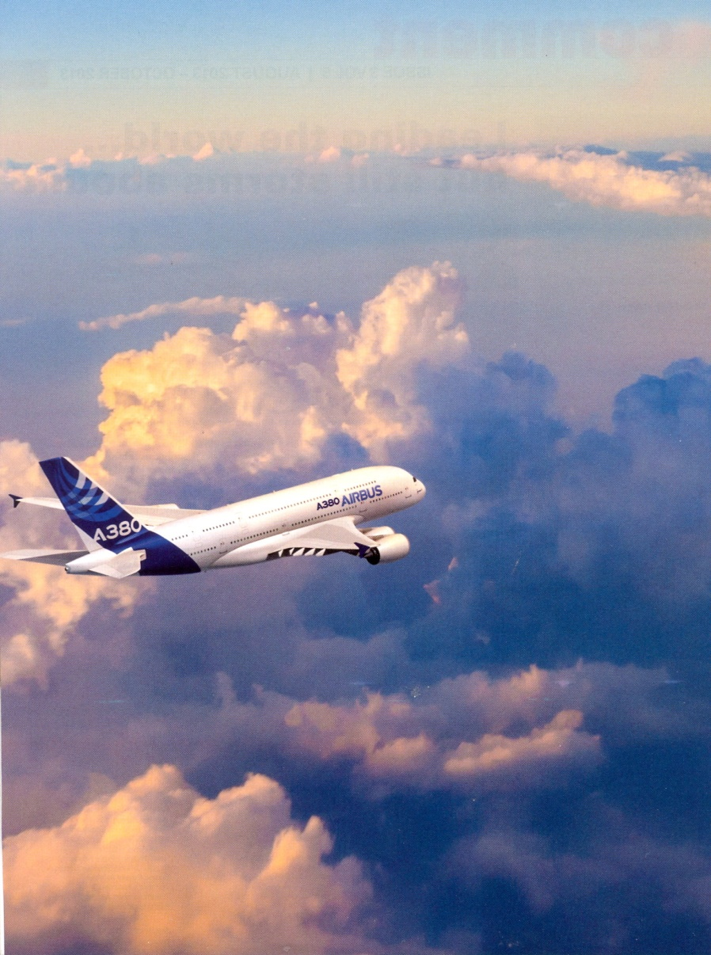
94. Name the 4 families of clouds.
Notes:
91

Slide 92
94. Name the 4 families of clouds.
1. High – Cirriform; 16,500 – 45,000 ft.
2. Middle – Altostratus, altocumulus, nimbostratus; 6,500 – 23,000 ft.
3. Low – Stratus, stratocumulus, fair wx cumulus; near the surface – 6,500 ft.
4. Extensive vertical development –
Towering cumulus, cumulonimbus
Pilot’s Handbook of Aeronautical Knowledge
Notes:
92

Slide 93
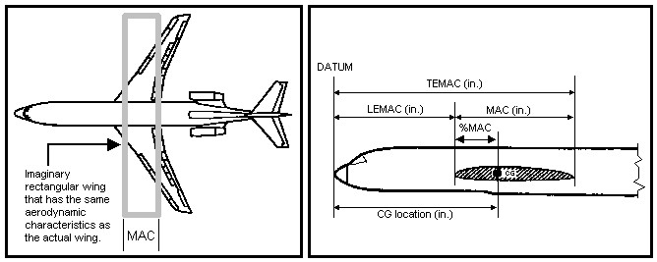
95. What is MAC?
93
Notes:
93

Slide 94
95. What is MAC?
  Mean Aerodynamic Chord;
  Distance between LEMAC and TEMAC on an imaginary airfoil.
  Weight & Balance Advisory Circular
94
Notes:
94

Slide 95

Define “Ceiling”

Slide 96
Define “Ceiling”
The height above ground of the lowest layer of clouds or obscuring phenomena reported as broken or overcast covering more than half the sky.

Slide 97
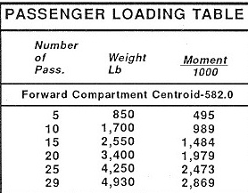
96. What is an Index Number?
Index Numbers
97
Notes:
97

Slide 98
96. What is an Index Number?
A simplified moment divided by 1,000 or 10,000.
Weight & Balance Manual
Index Numbers
98
Notes:
98

Slide 99
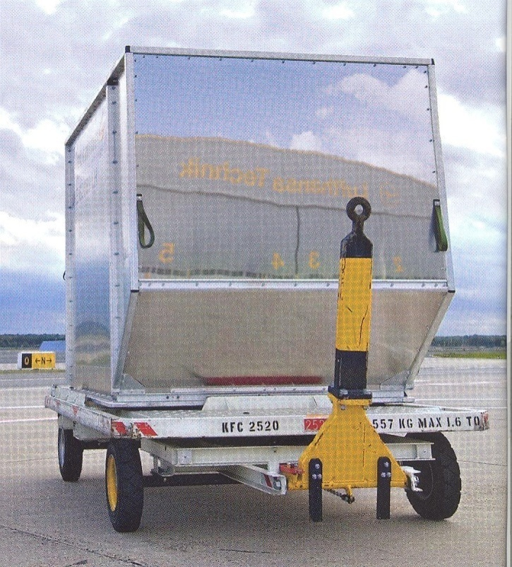
97. What is PAYLOAD ?
99
Notes:
99

Slide 100
97. What is PAYLOAD ?
  Cargo and or passengers;
  something someone paid to transport.
  Weight & Balance Manual
100
Notes:
100

Slide 101
98. What is ZFW ?
What is ZFW for the B-737-300?
101
Notes:
B737-300 Weight and Balance Form
101

Slide 102
98. What is ZFW ?
  Zero Fuel Weight
  Basic Operating Weight + Payload
What is ZFW for the B-737-300?
  106,500 pounds Max
102
Notes:
102

Slide 103
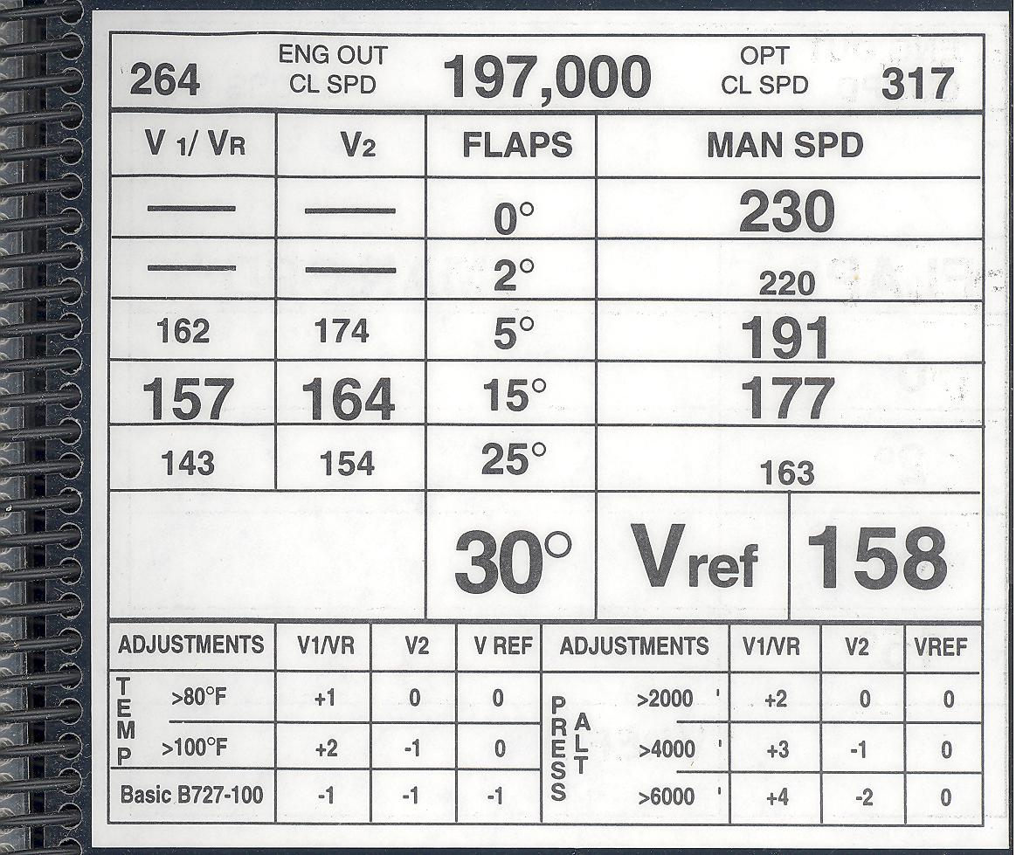
99. What is Vref?
103
Notes:
103

Slide 104
99. What is Vref?
Reference speed on which various speeds / flap settings on approach and landing are predicated based on the estimated landing weight.
FAR Part 1 Definitions
104
Notes:
104

Slide 105
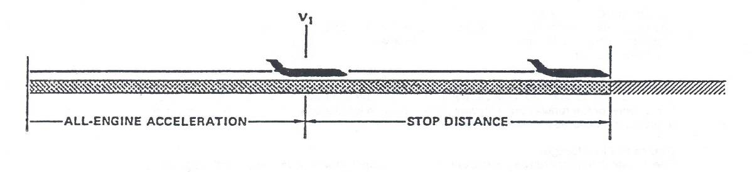
100. What factors affect V1 speed?
105
Notes:
105

Slide 106
100. What factors affect V1 speed?
  Headwind / tailwind; Aircraft weight;
  Runway slope; length OAT;
  Engine anti-ice ON; PowerPlant type
  Anti-skid inoperative;
  Contaminated runway;
  Performance Manual
106
Notes:
106

